Slide 1
Local practice of Science Education in Cambodia
“Belt and Road” Teenager Maker Camp and Teacher Workshop
17th-22nd December 2017
Beijing, PRC

Slide 2
Content
Country Figures
Science Education in Cambodia
Technical Education at Upper Secondary Level
  Vision
  Goals
  Core Competencies
  Objectives by Subjects and Sub-subjects
  Subjects and Study Hours
  Teaching Principles
  Learning and Teaching Assessment
  Teacher Professional Development
  Curriculum Framework Implementation
Conclusion

Slide 3
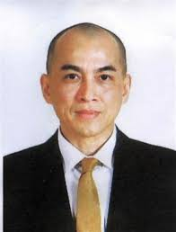
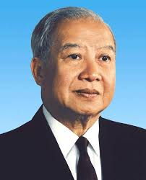
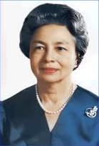
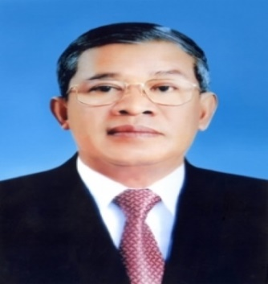
Country Figures
King King Father Queen Mother
Official name: The Kingdom of Cambodia
Political system: Democracy
  National Assembly and Senate
King: Norodom Sihamoni
Prime Minister: Aka Moha Sena Badei Tejo Hun Sen
Prime Minister

Slide 4
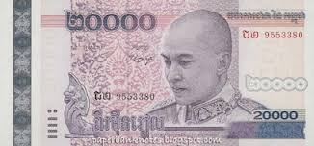
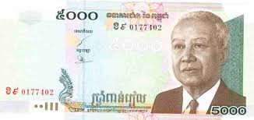
Capital: Phnom Penh
Language: Khmer (Cambodian)
Religion: Buddhism (official), Islam, Christianity
Population: 15,762,370 (2016)
    Khmer 90%, Vietnamese 5%, Chinese 1%, Others 4%
Land size: 181,035 Km2 (Density 81.8/km2)
GDP: $20.953 billion (total) and $1,308 (per captia)
Currency: Riel (1US$= 4,050R)

Slide 5
Science Education
- The 1980s – Reborn Period, establishment & rehabilitation;
- The 1990s – Reforming/ Restructuring/Development;
- 1996-1997 - Privatization in HE & Private HEI
- The Early 2000s – Growth of Private HEIs
- 121 HEIs (48 public; 73 private HEIs) supervised by 16 Ministries
- Under MoEYS = 73 HEIs: 13 public, 60 private
- Categories of HEIs = institute & university
- Student Enrolments = Around 220,000ss (all levels)
- Faculty Member = Around 13,500 Teachers
- Majors of training (courses) = Around 230 (Skills)
Higher Education 2000s - Present
Higher Education from 1980s - 2000s
Source : Ministry of Education Youth & Sport 2004-2016

Slide 6
Science Education
Increase the export of the manufacturing products with non garment industry of up to 15% in total export share in 2025, and also increase the export of processed agricultural products of up to 12% in the total export share in 2025
Increase the industrial contribution to 30% in GDP Share in 2025 which the manufacturing share will increase to 20% in 2025.
To ensure the economic growth in the rate of 6-7%/year, Cambodia needs 35000 Engineers and 46000 Technicians by 2015 compared to 2010 (CDRI).
Source : Ministry of Education Youth & Sport 2004-2016

Slide 7
Science Education
More Engineering Enrollment and Higher Quality Graduates are expected in the coming years in order to response to Higher Skill demand by Industry
Source : Ministry of Education Youth & Sport 2004-2016

Slide 8
Technical Education​ at Upper Secondary Level
Background
Vision
Mission
Goals
Strategies
  Establishment of Legislative Framework to Support General & Technical Education System (3)
  Establishment of General & Technical Education System (3)
  Development & Revision of Technical Education Curricula & Textbooks (3)
  Establishment of Technical Education Facilities & Installation of Equipment (2)
  Training of Technical Education Teachers & Promotion of Teacher Qualification & Competency (3)
  Accreditation & Quality Assurance of Technical Education (3)
  Establishment Plan for Sustainability of Technical Education (4)
  Gender Mainstreaming (3)
Conclusion

Slide 9
Background
  For the ASEAN integration, Cambodia has focused on TVET service for youth’s skill development in terms of labor force.
  Technical education, partially different from TVET, plays key role in changes in Cambodian workforce.
  Cambodia cooperated with KOICA to develop the Master Plan for Technical Education at Upper Secondary Level, curricula for accounting, agriculture, electricity, electronics, and textbooks for each trade.
  At lower secondary level, technical education focuses on vocational orientation, life skills and career guidance for students.

Slide 10
  At upper secondary level, life skills & technical skills for students are provided in order to help support their family economies & the nation’s as a whole and to encourage students to continue lifelong education.
  Ministry of Education, youth, and Sports (MoEYS)’s programs encompass 2 streams at General and Technical High Schools (GTHSs) in 3 provinces
  GTHSs have operated various trades:
    Animal husbandry
    Agronomy
    Electronics
    Electricity
    Mechanics
    Accounting

Slide 11
  GTHSs:
    Kampong Chheuteal HS has started operating 4 trades: Electricity, Electronics, Agronomy, and Animal husbandry since 2003.
    Samdech Akka Moha Sena Padei Tejo Hun Sen Rota Khsach Kandal GTHS has started technical education with 2 trades: Electricity & Electronics since 2012.
    Prah Bat Samdech Prah Borom Neat Norodom Sihamoni GTHS has startedd the technical education stream with 2 trades: Electricity and Agronomy since 2013
    Kampong Speu Institute, Kg. Speu
    Chumpou Voin HS, Phnom Penh
    Rota Khach Kandal, Kandal
    Kampong Cheuteal, Kg. Thom
  Master Plan for Technical Education was adopted in 2014 in cooperation with KOICA.

Slide 12
Vision
Students acquire excellent knowledge, technical skills and moral values to meet labor market demands and to continue life-long learning.
Mission
  To orient, promote, and provide technical education services at upper secondary level in cooperation with stakeholders and development partners.
Goals
  Establish technical education system at upper secondary level
  Establish standards for technical education curricula
  Establish and expand standardized General and Technical High Schools in every province/city
  Increase enrollment rates in technical education stream.

Slide 13
Strategies
  Establishment of Legislative Framework to Support General & Technical Education System (3)
  Establishment of General & Technical Education System (3)
  Development & Revision of Technical Education Curricula & Textbooks (3)
  Establishment of Technical Education Facilities & Installation of Equipment (2)
  Training of Technical Education Teachers & Promotion of Teacher Qualification & Competency (3)
  Accreditation & Quality Assurance of Technical Education (3)
  Establishment Plan for Sustainability of Technical Education (4)
  Gender Mainstreaming (3)

Slide 14
Conclusion
Technical education has been officially implemented and integrated into the national curriculum of the general secondary level.
Research in the field of technical education should be promoted.
Training for technical teachers should be prioritized.

