Slide 1
Chinese Science Education: Policy, Practice, and Challenge
Li Xiuju, PhD.
China Research Institute for Science Popularization
18/12/2017

Slide 2
1. History of Chinese Science education
1900s
Modern school system was first built in China
1904, released a school regulation policy making physics, chemistry, and nature part of school curriculum
1978-2000
1978-1980s: elite oriented education system. prepare future scientists and engineers
1980-2000: mass education system. foundational scientific knowledge and basic science skills
2000-now
Curriculum reform in pursuit of quality education: for scientific literacy of all students.
1904

Slide 3
2. Chinese Science Education System
2.1 the world’s biggest science education system
Undergraduate: 1,091,654
special education schools: 48,125
Senior secondary school: 1,670,720
Junior secondary school: 3,488,430
Elementary school:5,633,906
Pre-school: 1,844,148

Slide 4
2. Chinese Science Education System
Senior secondary school
Junior secondary school
Science: biology, physics, chemistry, earth science(grade 10-12)
Basic education
Elementary school
Science: biology, physics, chemistry, earth science (grade 7-9)
9 year- compulsory education
kindergarten
Science (grade 1-6)
Science ( preschool)

Slide 5
3. Science Education Policies
Reform of the state curriculum of basic education
2001, National Science Curriculum Standards For The Full Time Compulsory Education (Grades 3-6)(trial Version)
2017, National science curriculum standards for the full time compulsory education(grade 1-6)
Outline of the National Scheme for Scientific Literacy (2006-2010-2020)

Slide 6
3. Science Education Policies: Cultivating Science Teachers
Pre-service teacher education
Free Normal Education
Professional development for in-service science teacher
National Teacher Training Program
Back to the university—— in-service professional development of science teachers in high schools

Slide 7
4. Science Curriculum System In A Secondary School
Elective
science festival/science camp /science lectures
All students who have interests in science
Elective
High potential in science students
Research curriculum
Elective
Students interested in Science
Advanced science curriculum
Compulsory
All students
School based-science curriculum
Compulsory
All students
National science curriculum

Slide 8
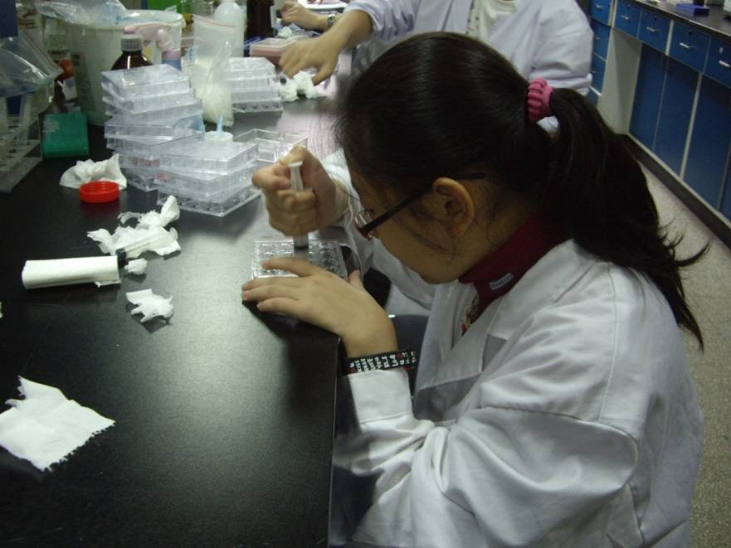
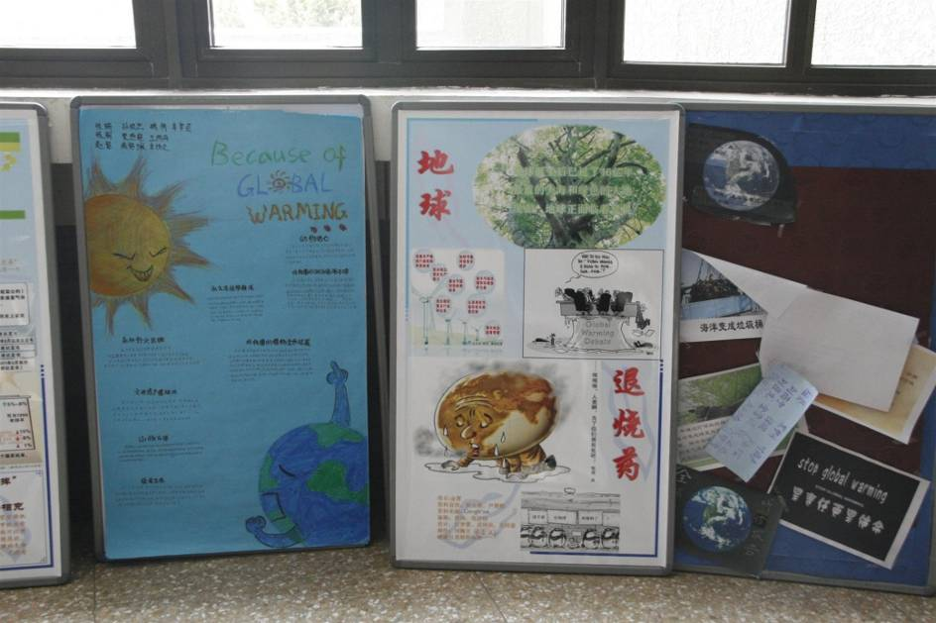
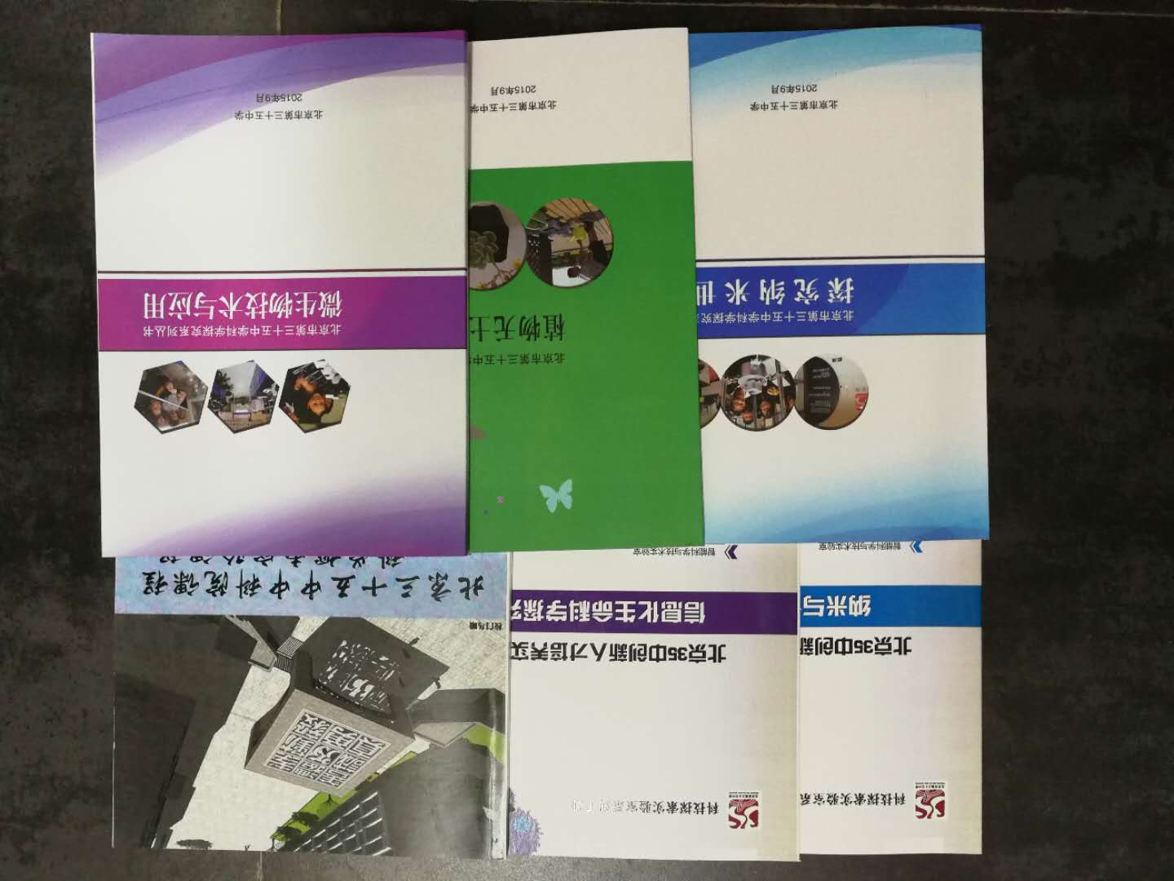
Students attend research curriculum
School based science curriculum textbooks

Slide 9
5. Informal Science Education
Promoting student pursue science
Cultivating science talents
Selecting science talents

Slide 10
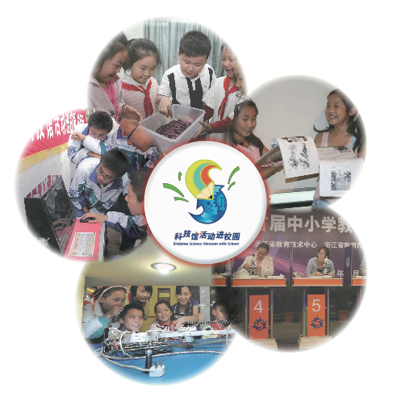
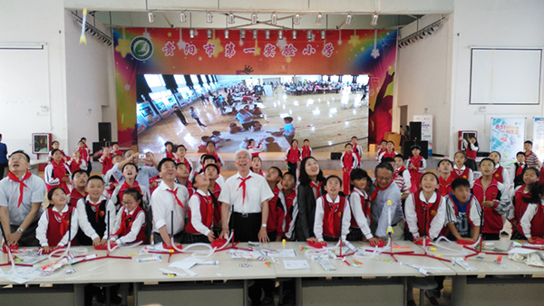
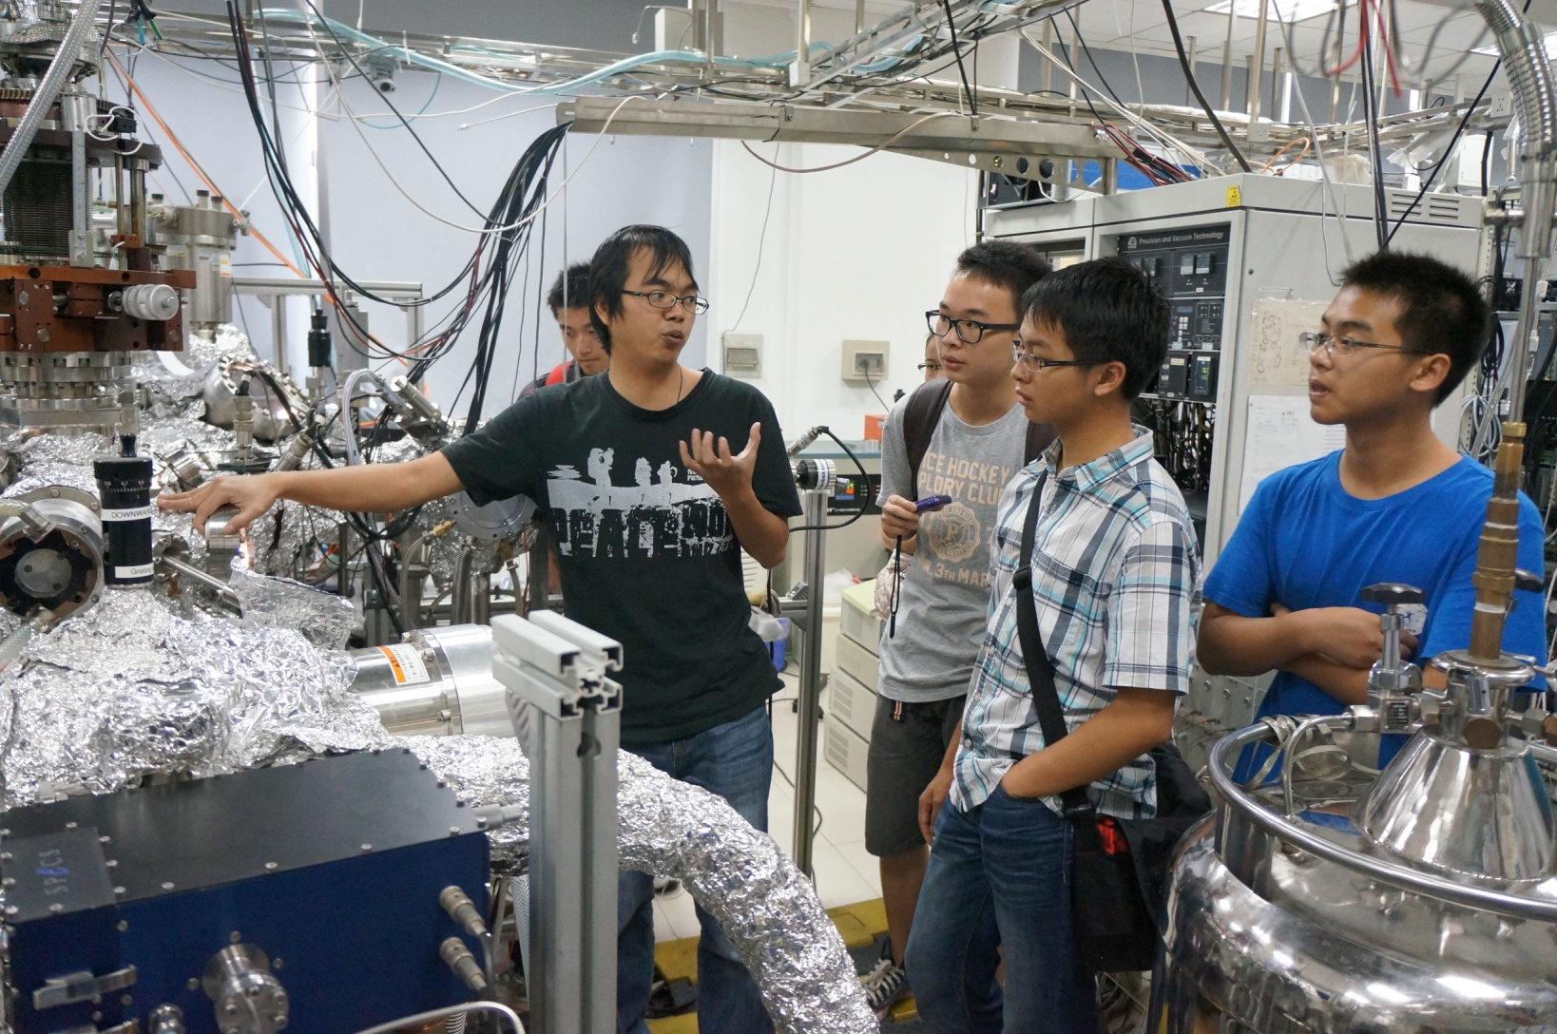
Promoting students pursue science programs:
Science camps in the universities
Bridging science museums to school
Adolescent scientific investigation experience

Slide 11
Case 1:Biology class taken In the museum
Beijing Museum of Natural History promotes a “Biology class taken in the museum” suitable for junior high school students.
The “Biology class taken in the museum” program is for two hours every two weeks in Beijing Museum of Natural History , and the students learn from museum experts about subjects such as paleontology, entomology, microbiology, botany and ecology either in the museum or in other places.
11

Slide 12
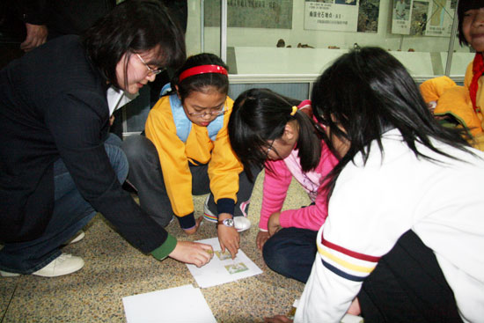
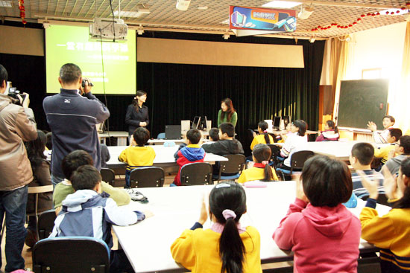
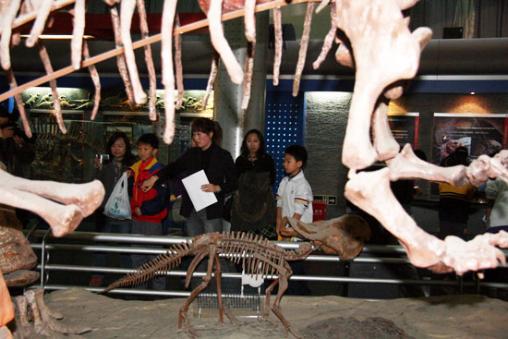
12

Slide 13
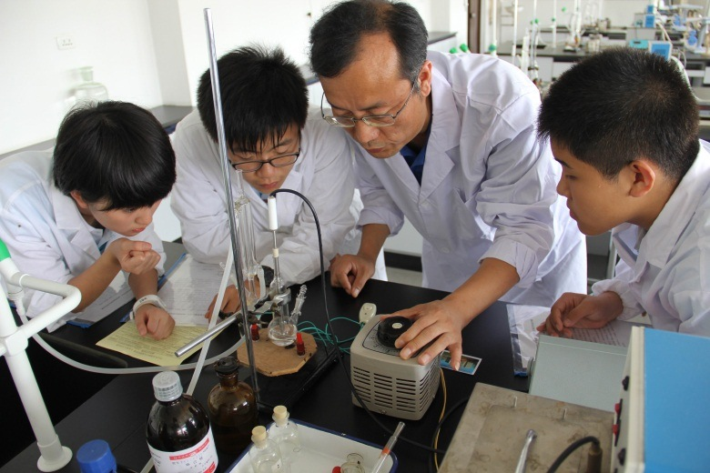
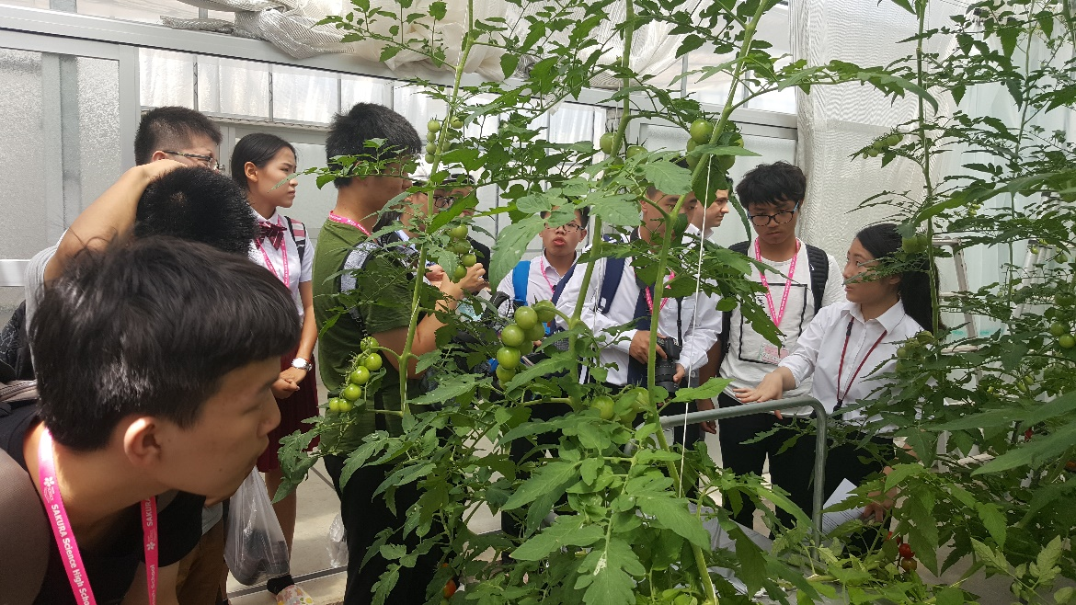
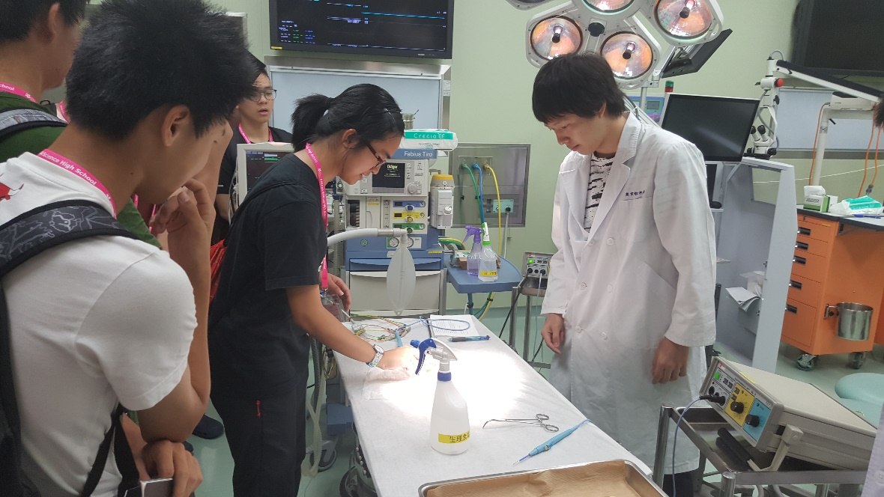
Cultivating science talents programs
The Young Science Talent Program

Slide 14
Selecting science talents programs
China Adolescent Science and Technology Innovation Contest (CASTIC)
China Adolescent Robot Competition (CARC)
Awards for Future Scientists (AFS)
Science Olympiads

Slide 15
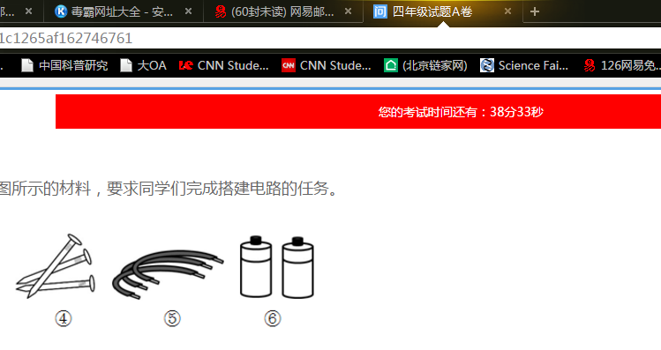
6. Assessing Students 'Scientific Literacy
CRISP science education team developed three assessing students 'scientific literacy tools for grade 4, grade 6, grade 8 students.
The tools includes four parts: physical sciences; life sciences; earth and space sciences; engineering and technology.

Slide 16
for Life science, physical science and earth science, each part has 10 items. For engineering and technology part, it has 4 items.
Most of items are multiple choice, each part has 1 short answers item.
In 2016, CRISP had finished two pilot surveys via paper and pencil in Beijing and Chongqing. We revised the three tools based on the pilot survey results.
In 2017, CRISP did the surveys online in Beijing, Shanghai, Fujian, Zhejiang provinces. Now we just finished the survey. We will revised the tools and online system based on these results.

Slide 17
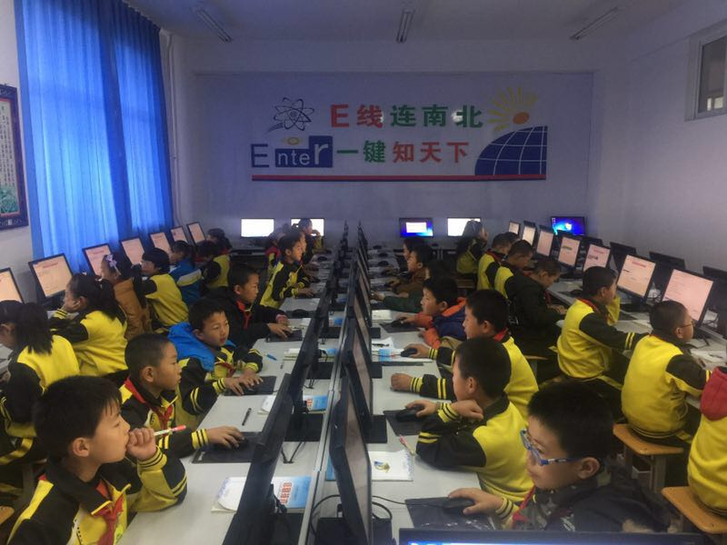
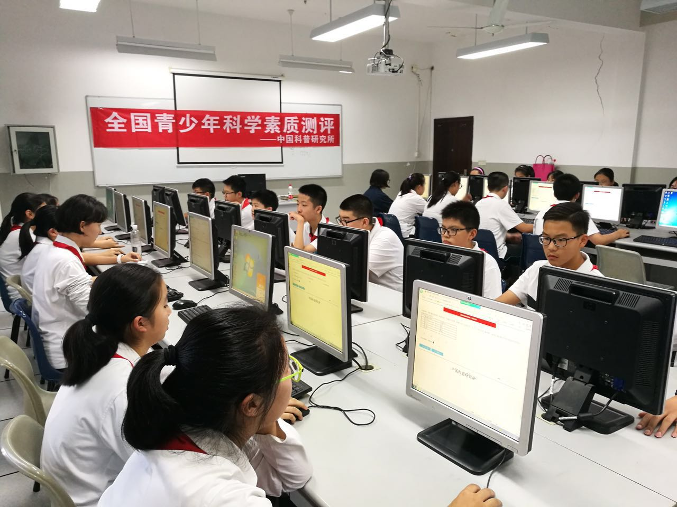

Slide 18
6. Challenges
Lack of science teachers: elementary science teachers
How to get a balanced development
Further deepening the collaboration between scientists and educators

Slide 19
Thank you for your patience!

