Slide 1

Introducing national organization for development of exceptional talents
A review of Science education experience over four decades

Slide 2
National organization for development of exceptional talents
The National Organization for Development of Exceptional Talents also known as the NODET was founded in 1976
Its main goal has been defined as the selection & development of talented students
This has been accomplished by establishing several schools all over the Iran
School name ,Allameh Helli, comes out in a memory of the muslim scientist Al-Hilli
(1250 -1325 CE)

Slide 3
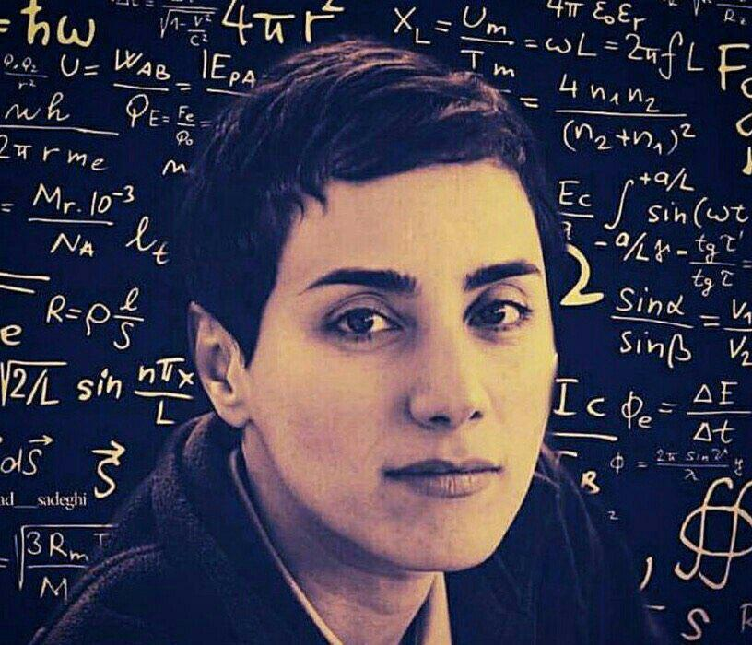
Honors & Alumni
There are many successful academics & individuals among the NODET alumni
Medal winner in different international Olympiads
A very well-known example prof. Maryam Mirzakhani; The Mathematician and late professor of Stanford University, The first woman honored with the Fields Medal. ( Known as mathematician Nobel prize )

Slide 4
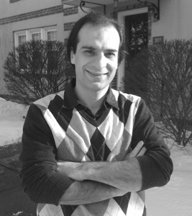
Honors & Alumni
Another example is prof. Arash Afraz, a research scientist at MIT McGovern institute for Brain Research, who discovers the mystery of face detection by human brain and honored many awards

Slide 5
Science education method in nodet schools
The science education in Allameh Helli school is based on experiments and practical activities and tact rather than just dealing with reading materials
An interactive method is used to teach scientific facts to students
Final assessments technically workshops, evaluating students instead of conventional public exams

Slide 6
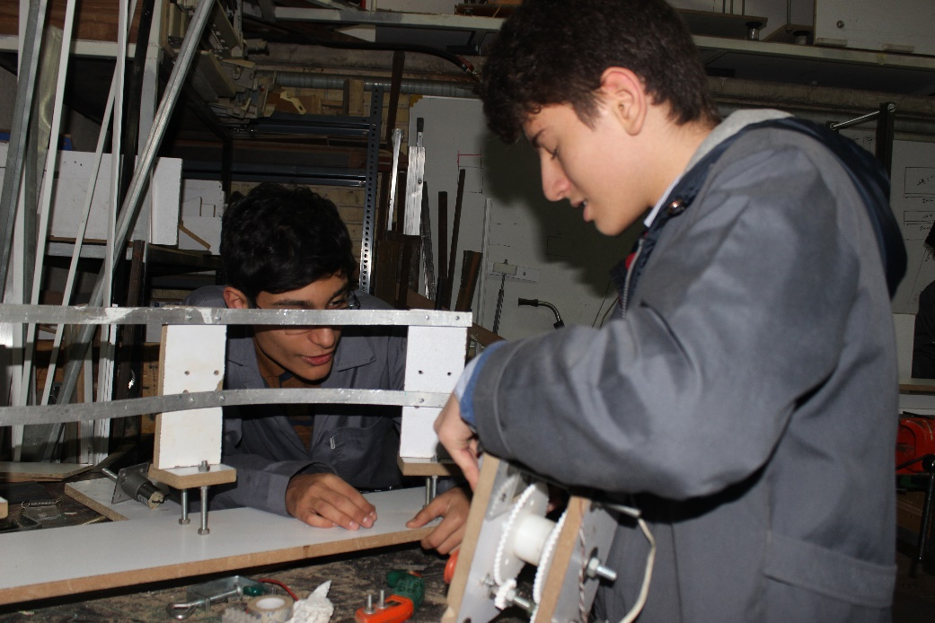
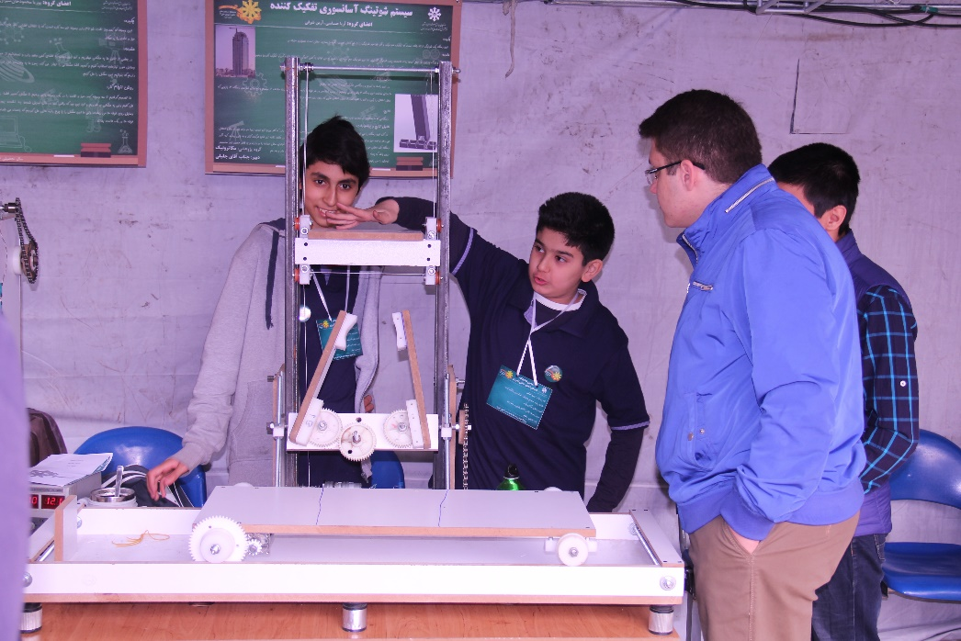
Science and technology fair
All students do a science or technology project through team working every year

Slide 7
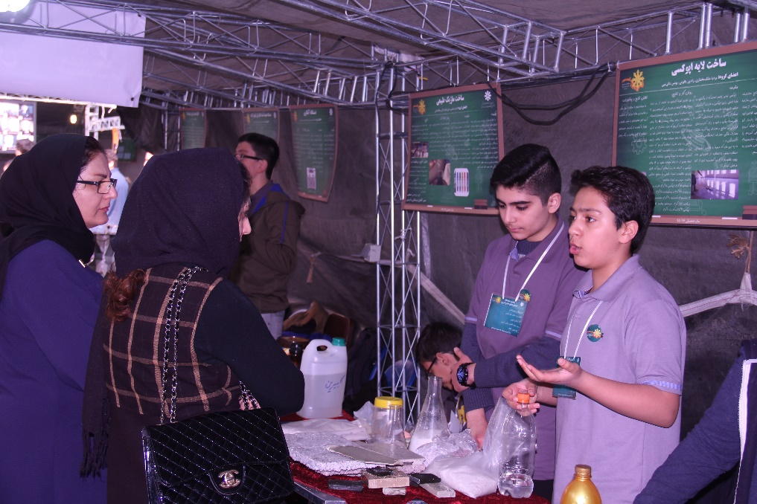
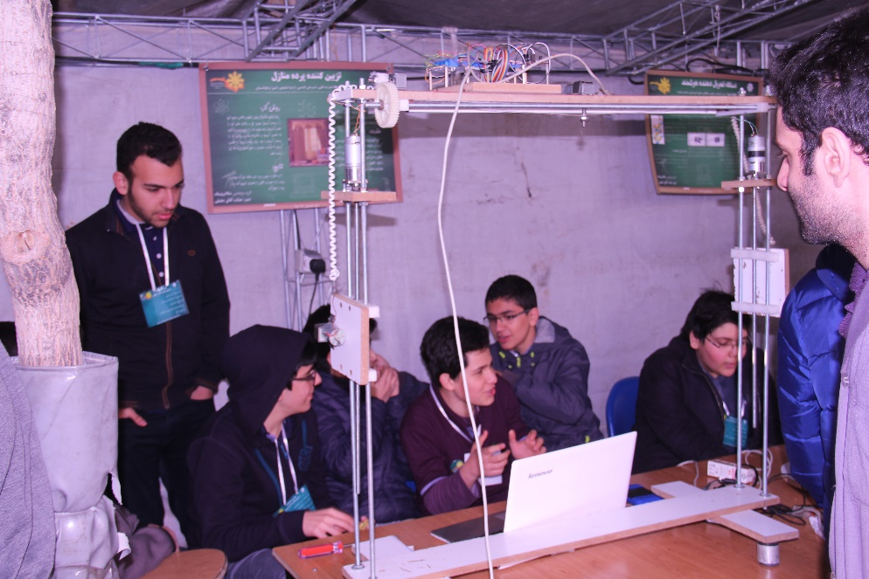
Science and technology fair
After completing and finishing this projects week by week, they prepare themselves to participate in The Annual Science and Technology Fair

Slide 8
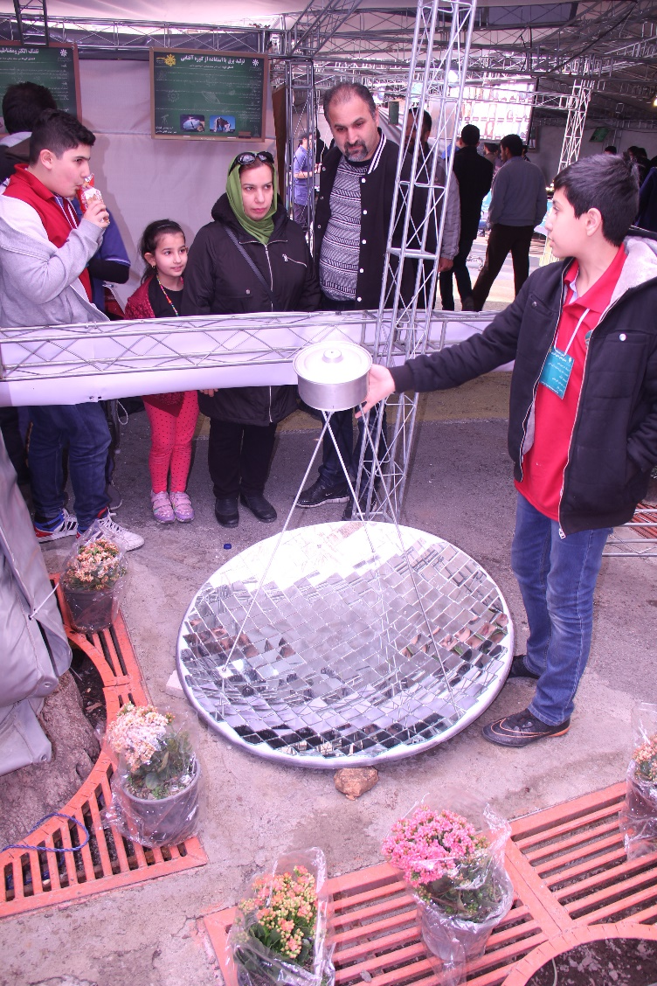
Science and technology fair
This fair which is organized and managed by the student have many visitors every year
Students from other schools, teachers and parents are among the visitors

Slide 9
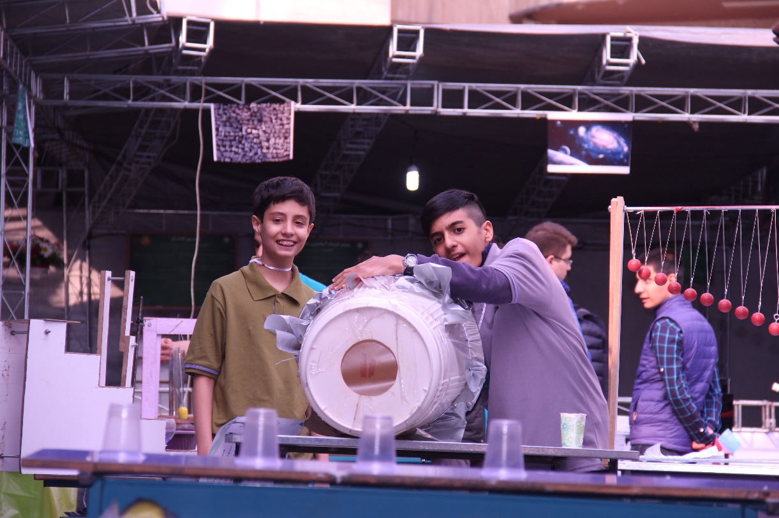
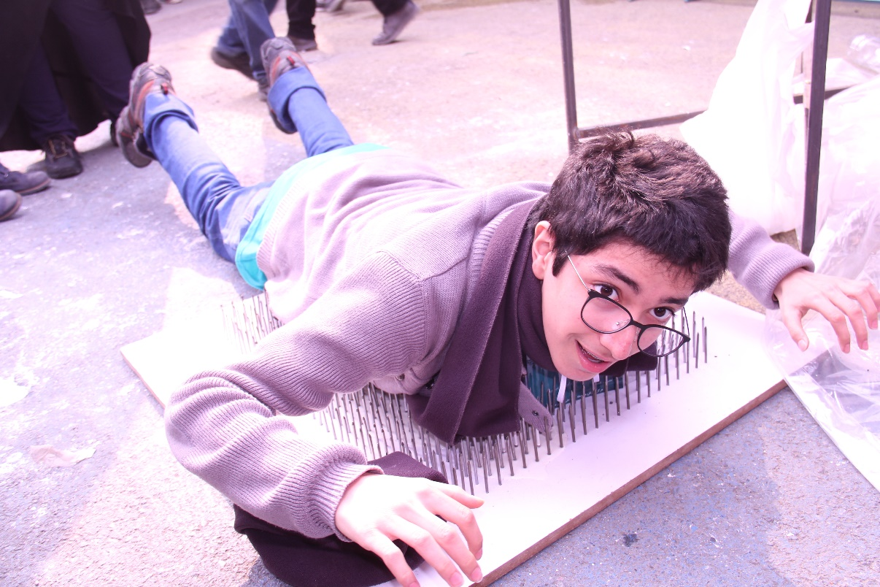
Science and technology fair

Slide 10
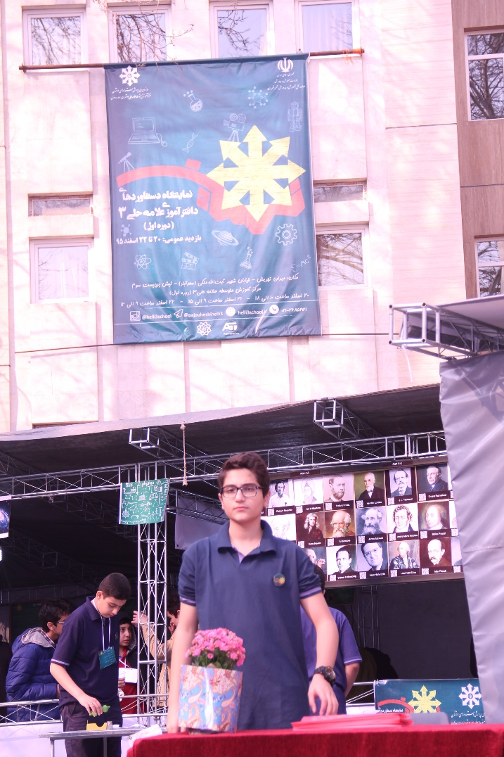
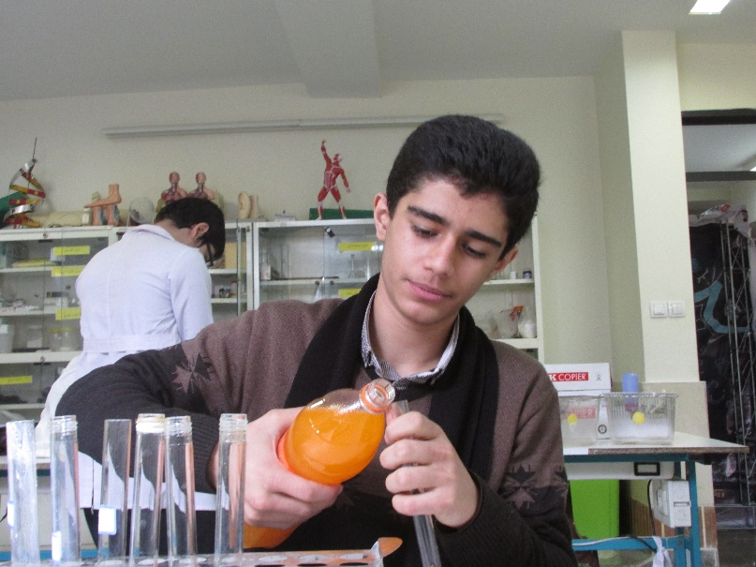
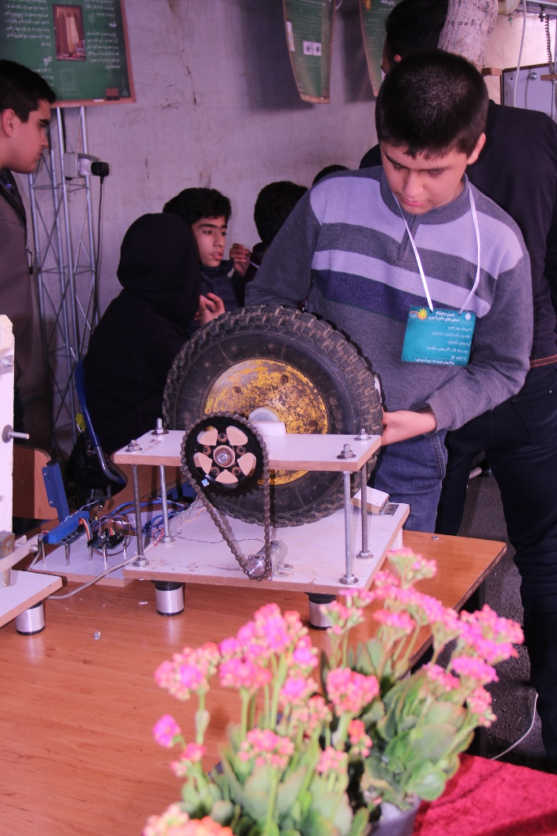
Science and technology fair

Slide 11
Science and technology fair

Slide 12
Rope workshop!
Rope workshop, the recent workshop held in our school was actually designed to teach some physical principles to student through team working
One of the exclusive events in this workshop, was the attendanace and participation of parents alongside with their children
And a video clip is showing what they were dealing with:

