Slide 1
ECOLOGY, INNOVATIONS AND EXPO - THE PLATFORM FOR INTEGRATION OF WOMEN and TEENAGERS OF THE WORLD
Republic of Kazakhstan

Slide 2
In 2016
Becoming partner of festival
«Fashion and Scene» in
Kazakhstan
EXPO WOMEN
EW was created
24 June 2015 year
Member of
UNESCO, ISTIC, ECOSF, EEI, IRIS, INSTP, IRENE
May 26 of 2016 had organized
Republic forum
Investment of women and teenagers in preforming
Expo 2017
With help of INSTP participating
Innovators camp in Iran
11-17 December 2017year
Initiator of craftsmen fair
«Uly dala Zharmenkesy»
Registration of new filial of EXPO-WOMEN in Mangystau, Kazakhstan
2-3 august 2017 Future energy: women, business and global economic in Astana

Slide 3
EXPO WOMEN

Slide 4
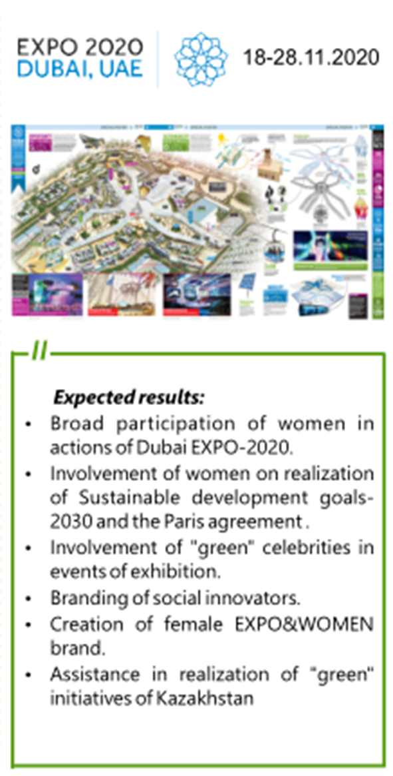
EXPO WOMEN
EXPO-Beijing 2019
EXPO-Dubai 2020
Forming new generation of Kazakhstan’s scientists
Development of critical thinking skills among students
Promotion of scientific achievements of Kazakhstan women and teenagers on world area

Slide 5
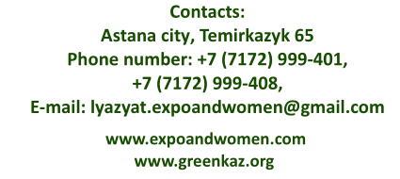
THANKS FOR YOUR ATTENTION

