Slide 1
«Science education»
presentation of team Kazakhstan-2
«National School of Physics and Mathematics» from Almaty city
speaker: physics teacher Bolat Kabdiyev

Slide 2
Our school «National School of Physics and Mathematics» (in abbreviated form: RPMS) began its work in 1972 in Almaty city . The main goal of RPMS is to prepare well-educated graduates with an intensive training in physics and mathematics. Our graduates after receiving a higher education, successfully engaged in scientific work in Kazakhstan and outside the country.

Slide 3
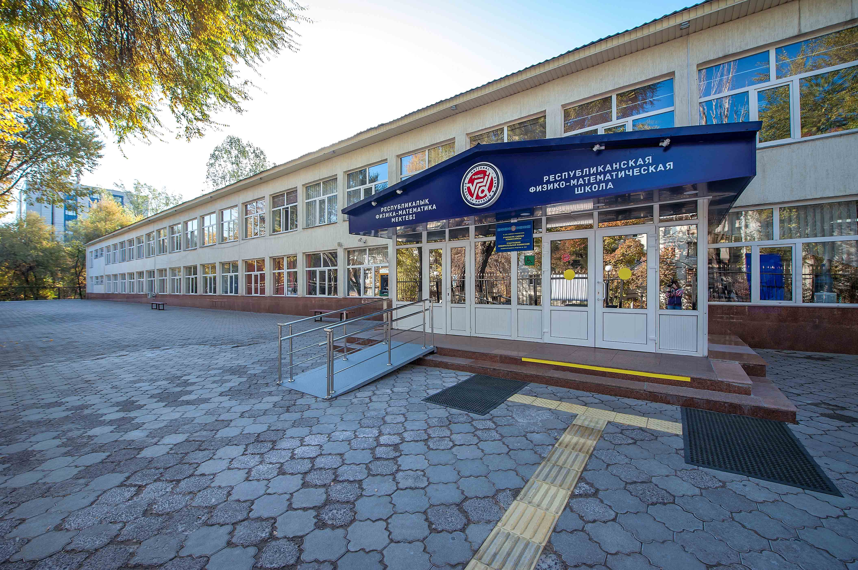

Slide 4
Children come to RPMS on a competitive basis. They take entrance exams in physics, mathematics and English. From the beginning the students get used to a competitive environment. Then when training children undergo a competitive selection for admission to the group of Olympic reserve in physics, mathematics and other branches of science.

Slide 5
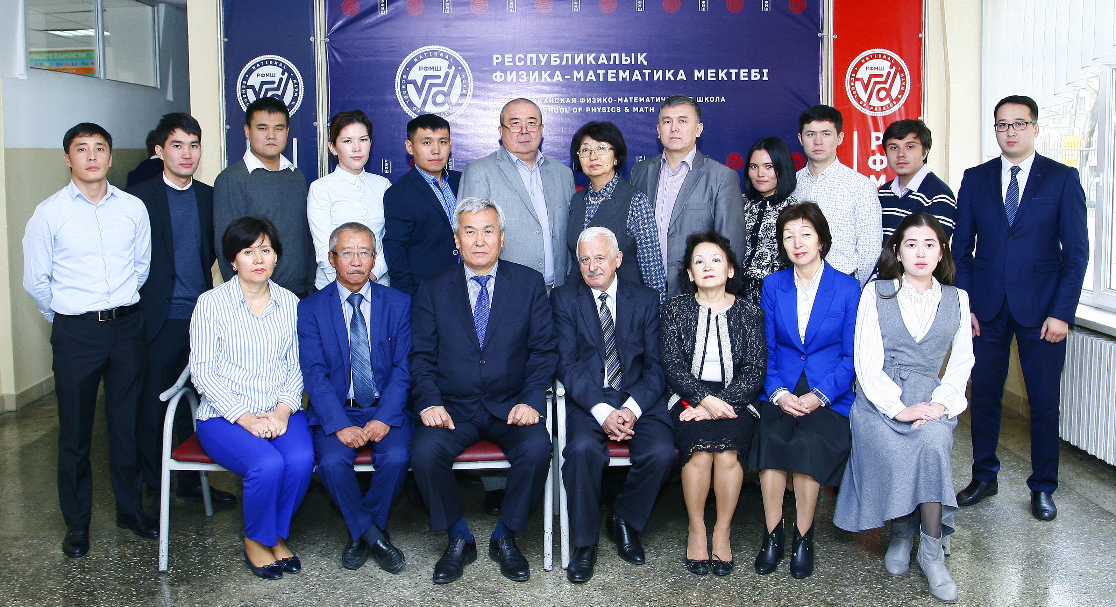

Slide 6
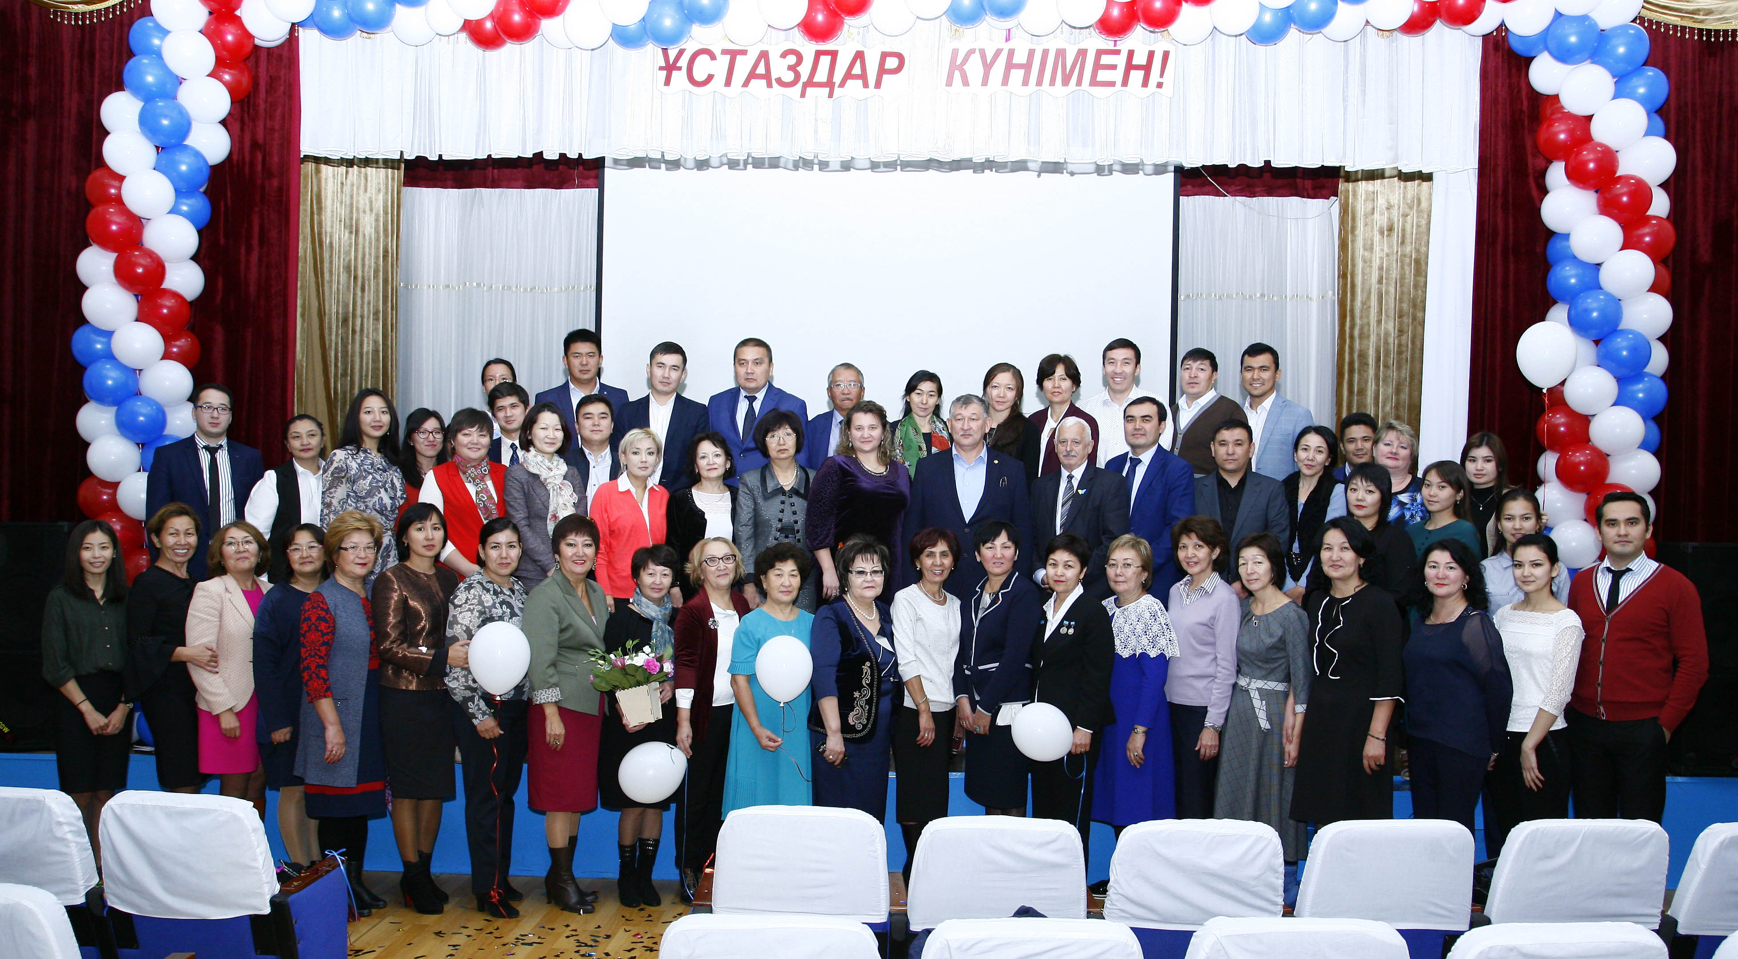

Slide 7
Lessons in these groups are held in the afternoon after the completion of major lessons. Lessons are lead by experienced teachers. It can be not only teachers of RPMS, but also invited teachers from other schools. As a result of systematic training of students in our school often participate in international and Republican competitions and take prize-winning places.

Slide 8
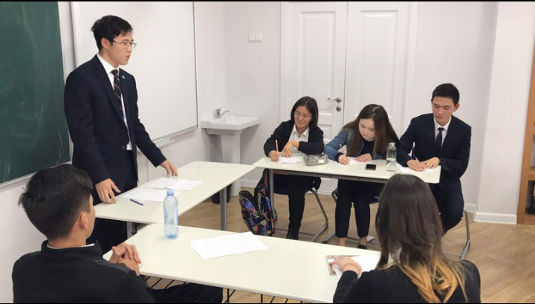

Slide 9
International Olympiads
in physics, mathematics, computer science
The students of RPMS in the national team of Kazakhstan has won many awards at international science competitions:
- Physics (IPhO): 3 gold, 5 silver and 2 bronze medals
- Mathematics (IMO): 2 gold, 7 silver and 26 bronze medals
- Computer Science (IOI) : 1 gold, 3 silver, 4 bronze medals

Slide 10
Imtenational competition for science and technology (ISEF INTEL)
2003 year | 4 th place
2004 year | 4 th place
2009 year | 3 rd place
2014 year | 4 th place
2015 year | 4 th place

Slide 11
Choice of graduates of RPMS today
Russia - 35
USA – 4
МГУ
МГТУ
МИСиС
ВШЭ
МИФИ
МФТИ
МГИМО
5
7
8
6
5
2
2
NYU
PSU
Towson
UCLA
1
1
1
1
6%
10%
5%
64%
Europe - 4
Asia - 18
15%
TU Graz
LES ROCHES
Karlov Unv
2
1
1
SJTU
HKU
KAIST
11
4
3
292 graduate of 2017

Slide 12
The choice of Kazakhstan universities graduates 2017
СДУ
МГУ
4%
Прочие
4%
15%
Nazarbayev University
37%
МУИТ
10%
КазНУ
13%
КБТУ
17%

Slide 13
Organization and holding of annual international Zhautykov Olympiad in physics, mathematics and computer science (official website: http://izho.kz).

Slide 14
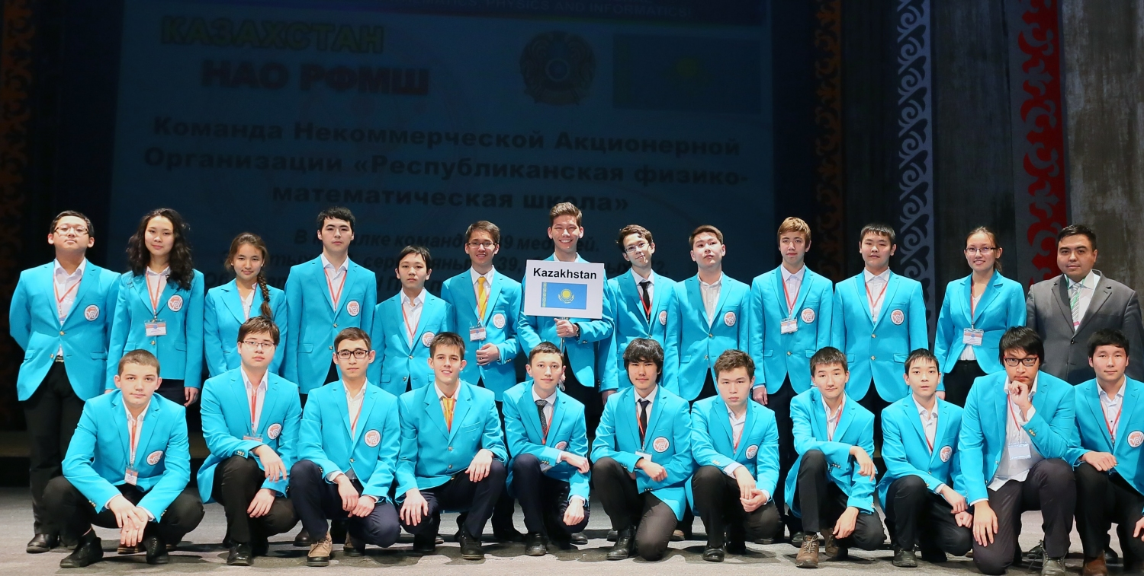

Slide 15
Every year in January RFMS holds an international Zhautykov Olympiad in physics, mathematics and computer science. Involved over 300 children from 15-17 countries. List of Participants at 2017 year: Russia, Kazakhstan, Serbia, Czech Republic, Romania, Georgia, Bulgaria, Mongolia, Turkmenistan, Azerbaijan, Uzbekistan, Belarus, Tajikistan, Kyrgyzstan and Armenia.

