Slide 1
Learning Science in Informal Environment with National Science Museum, Thailand (NSM)
Sri-apa Rumrat
National Science Museum, Thailand
Sri-apa@nsm.or.th
Notes:
Hi Everyone, I’m Sri-apa Rumart, Science Educator of the National Science Museum, Thailand. My session will be on “Learning Science in informal environment with National Science Museum, Thailand”

Slide 2
OUTLINE
Informal Science Learning
About NSM
NSM Education program
NSM Enjoy Maker Space
Notes:
There are Four main topics that I will be presenting today.

Slide 3
Informal Science Learning
Learning science in informal settings like visiting museums, meeting scientists, involving with outside school program, watching YouTube videos and playing games – offer huge potential for young people to engage with and learn about science in a way that works for them.
(Wellcome Trust, 2012 and Ben et al, 2009)
Notes:
Informal Science Learning
Is learning science in informal settings like visiting museums, meeting scientists, involving with outside school program, watching YouTube videos and playing games, which offer huge potential for young people to engage with and learn about science in a way that works for them.

Slide 4
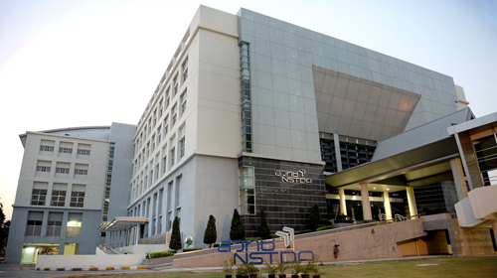
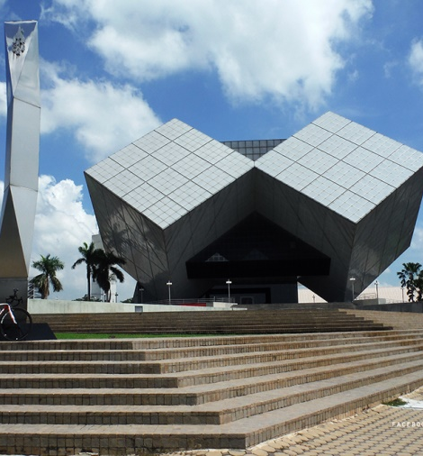
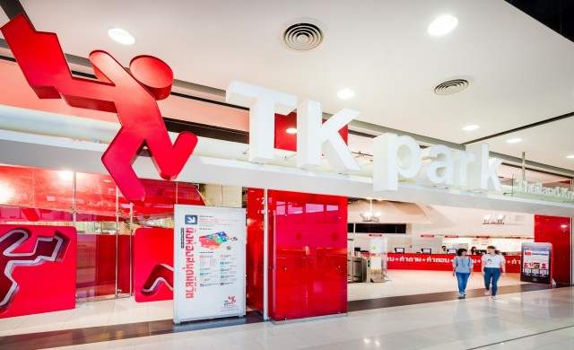
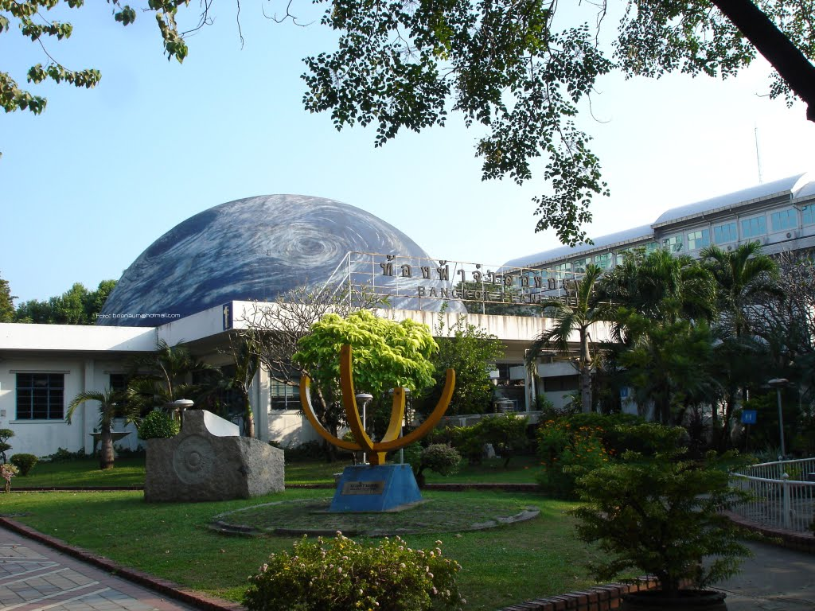
Informal Science Learning Venues in Thailand
Notes:
In Thailand, we have many informal learning settings to serve Thai people, particularly young people. For example, Aquariums, Education and Library centres, science and technology institutes, planetariums and science museum.

Slide 5
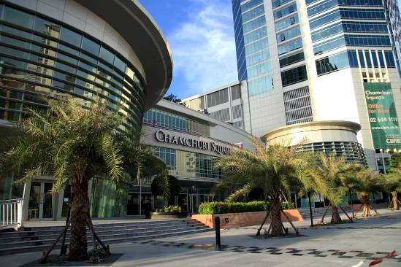
About NSM
Science Square
Notes:
For nearly 20 years, the National Science Museum or NSM is an important informal learning setting that plays significant roles in promoting learning, understanding and creating awareness of science for Thai people.
NSM is under the supervision of the Thai Ministry of Science and Technology. Now, three museums and one education centre are opened for the public. Where the science museum, natural history museum, and information technology museum are in 22 acres area at Pathum Thani province. In the capital city of Bangkok, there is the science square. In the next few year, we will open two huge museums; the RAMA 9 Museum and the Futurium.

Slide 6
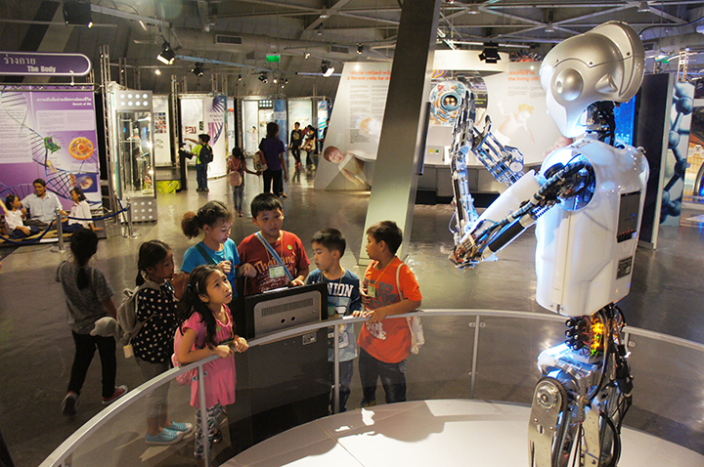
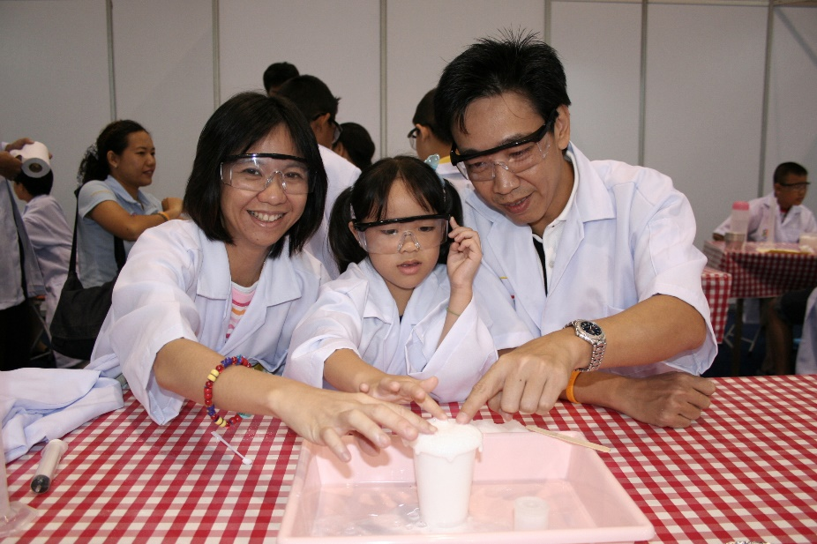
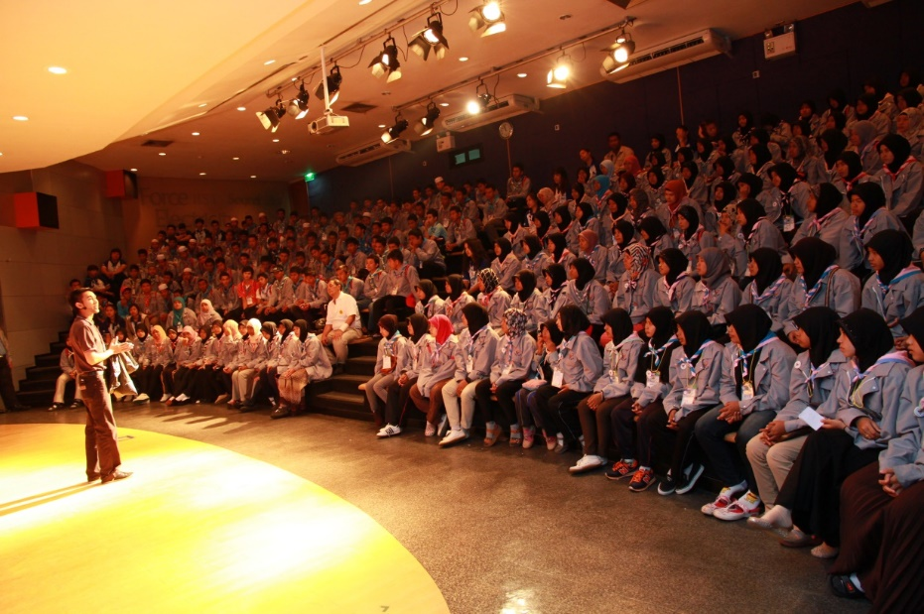
NSM Education Program (1)
Science Exhibition
Science Lab
Science Camp
Science Show
Planetarium
Notes:
With NSM, visitors can engage and enjoy many education programmes that we have developed and provide for them. For example, Science Exhibitions, Science Show, Science Lab, Science Camp and Planetarium.

Slide 7
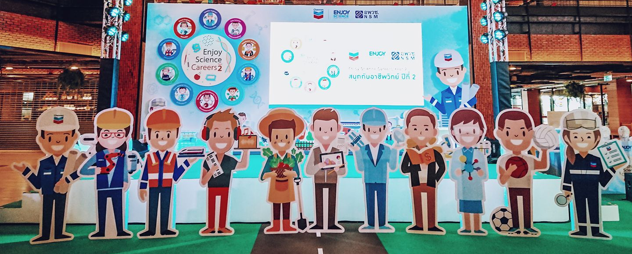
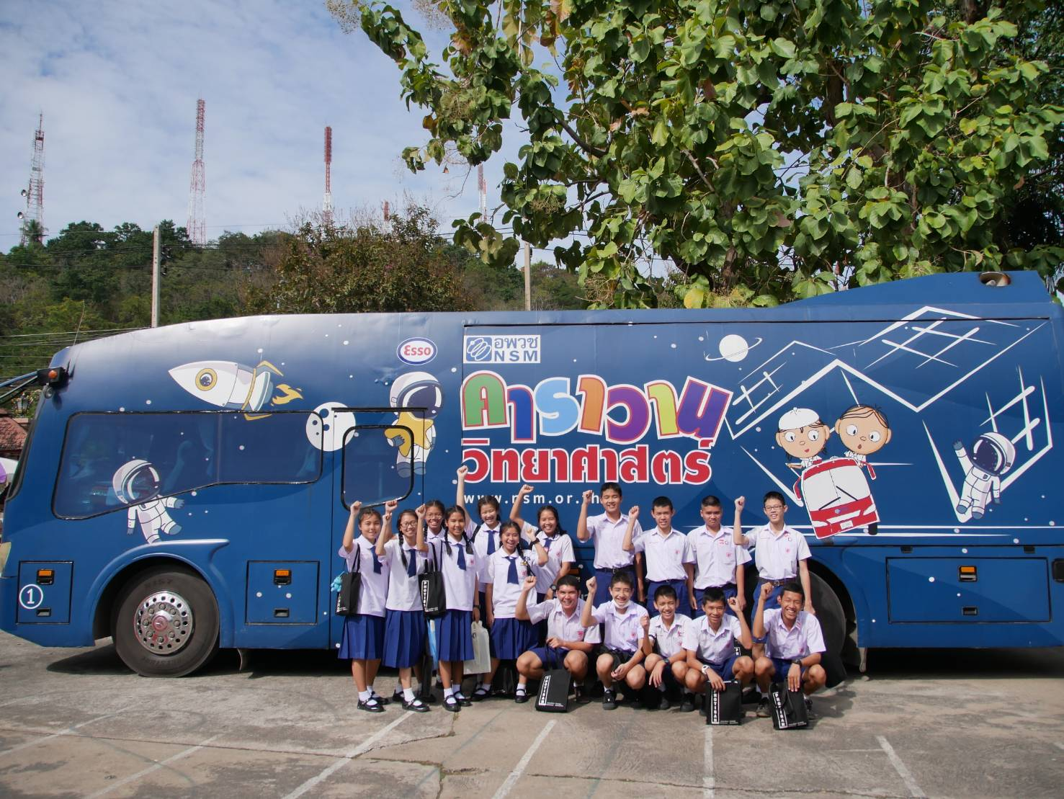
NSM Education Program (2)
Enjoy Science Career
Science Caravan
Research Show
Notes:
Additionally, we have more education programmes such as Enjoy Science Career and Research show to serve young people. These programmes inspired young participants' interest in Science Career for their future.
Last but not least, we also considered about the local young people who lack the opportunity to visit and experience NSM at Phathum Thani. We designed an outreach science programme called “Science Caravan” to travel to different remote areas of Thailand to promote science learning and experiences with hands-on science exhibitions, laboratory, show and games. This outreach program have served local young people for more than 10 years.

Slide 8
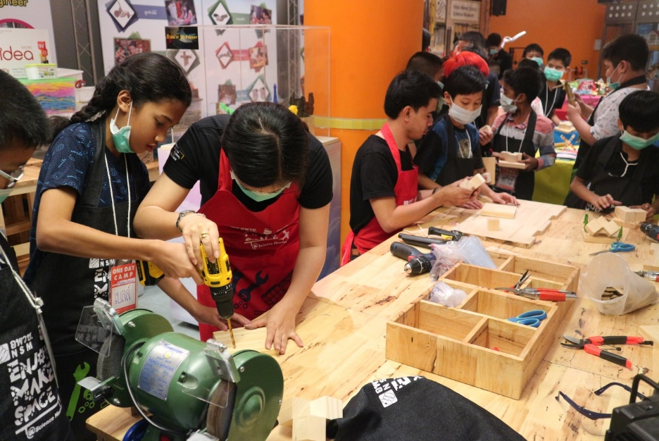
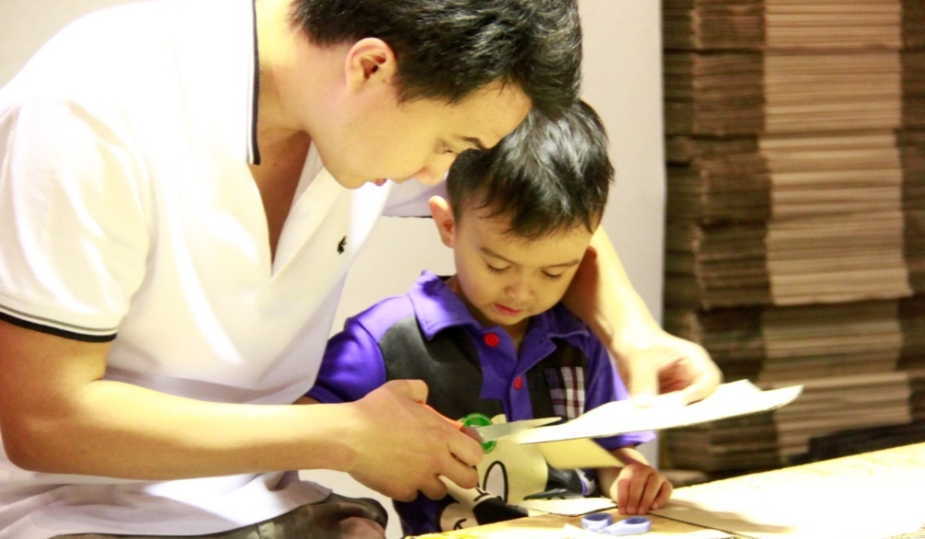
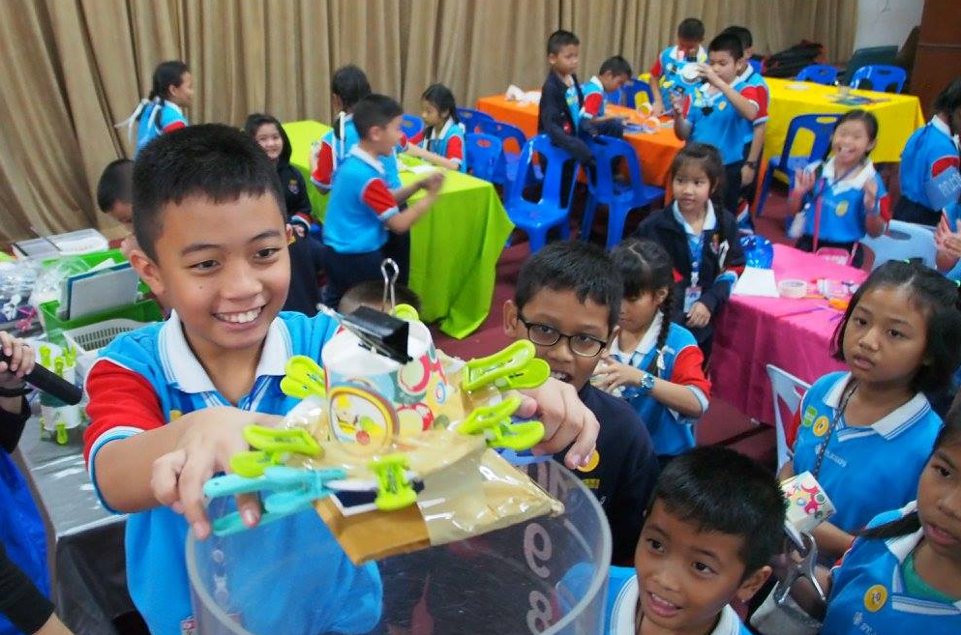
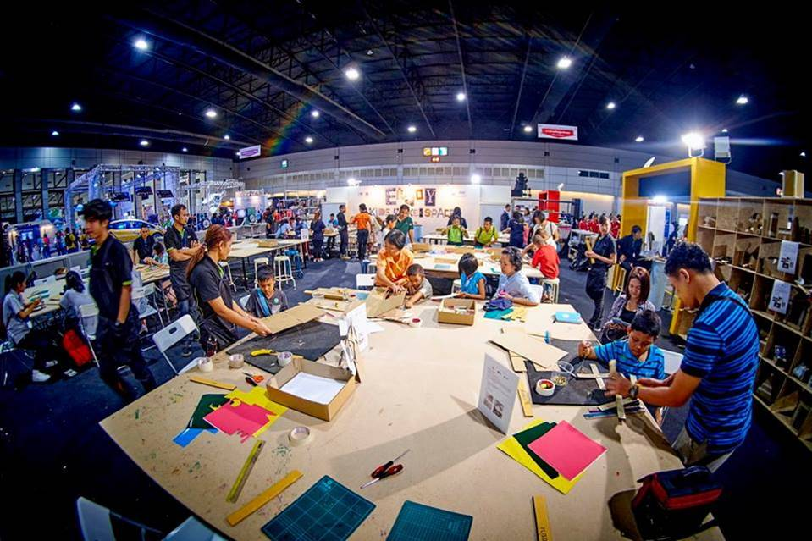
NSM Enjoy Maker Space
Notes:
NSM provided education program to encourage participants develop their learning and creativity Activity Development Frameworks; Deconstruction, Discovery, Design/Making and Display. This program is called “Enjoy Maker Space”. It was sponsored by Chevron Thailand. There are four main venues of NSM Enjoy Maker Space that Thai people can have access to this program;
Firstly, Enjoy Maker Space @Science Museum, for visitor of the Science museum, we have provided maker space with various hands tools.
Secondly, Enjoy Maker Space @Science Square, for young people and families who live in capital city.
Thirdly, Enjoy Maker Space @National Science Fair. this program is a part of many science activities and exhibitions in the National Science Fair, which is arranged every year in August. Majority of the visitors are school students. They can enjoy maker activities with various hands tools in a huge space.
Finally, Enjoy Maker Space @Science Caravan, which allow local young people in remote areas to have opportunity to engage with Enjoy Maker Space.
Moreover, we also have more education programs that are not presented here. If you would like to know more. Please feel free to share with me after this presentation.

Slide 9
Creating a Scientific Society for
the Sustainable Development of the Nation
National Science Museum, Thailand
Technopolis, Klong 5 Pathum Thani, 12120
Tel +66 (0) 2577-9999
www.nsm.or.th

