Slide 1
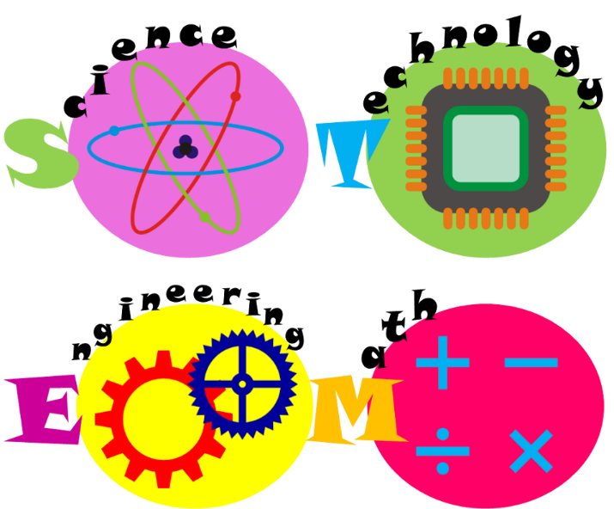
OUR STEM STORY
Team: Vietnam
Presenters:
+ Nguyen Thi Van
+ Nguyen Minh Nguyet
vanmitu@gmail.com

Slide 2
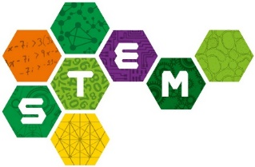
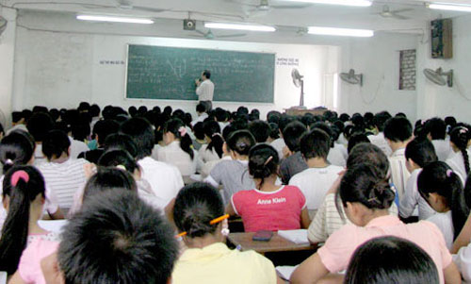
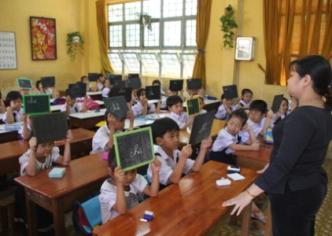
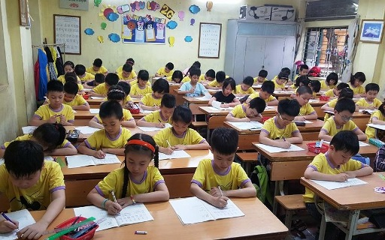
POPULAR TEACHING METHOD
Theory – based learning

Slide 3
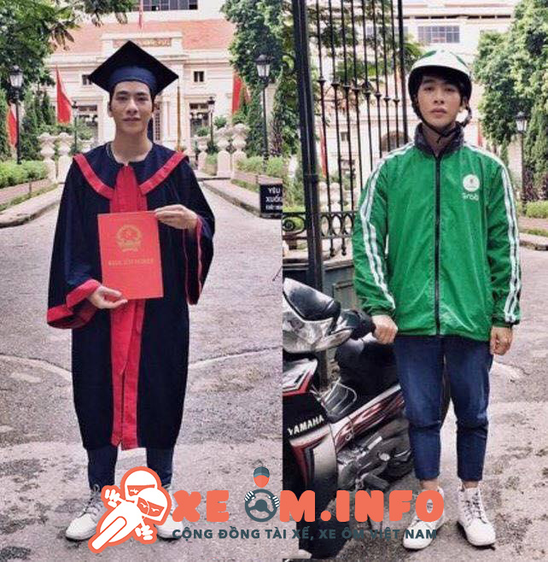
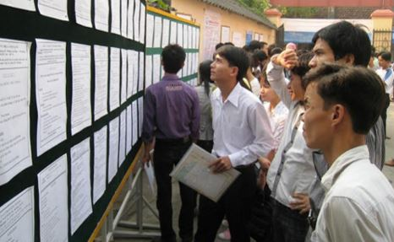
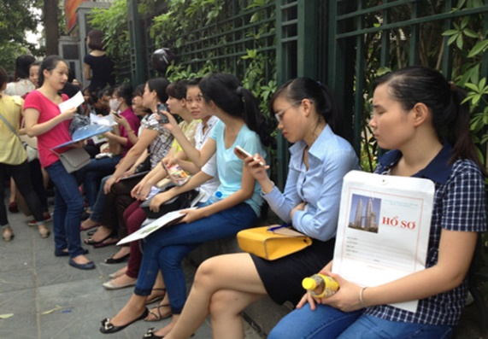
LABOR WORKFORCE
Lack of skills
Unemployment
Do a job not related to their major

Slide 4
A PICTURE OF CHANGES
Changes
High level meetings
Change form of exams
ToT projects
Change text books
Import curriculum

Slide 5
STEM TREND
A breakthrough in training trend in Vietnam

Slide 6
STEM PRACTICE IN VIETNAM
2. Forms of
practice
1. STEM doers
3. Effects
4. Challenge
5. Future

Slide 7
STEM DOERS
1
Private education companies
2
Private schools
3
Teachers with STEM passion
4
Community Training Center (1)
5
Skilled individuals

Slide 8
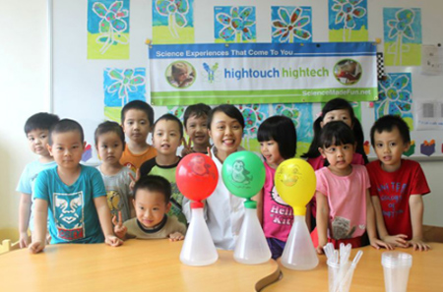
STEM DOERS

Slide 9
FORM OF PRACTICE
STEM ECOSYSTEM
SCIENCE FAIR
STEM CLUB
STEM ToT
STEM COMPETITION
STEM For MANAGER
STEM LIBRARY
STEM for WOMEN
SCHOOL BUS
in mountainous area

Slide 10
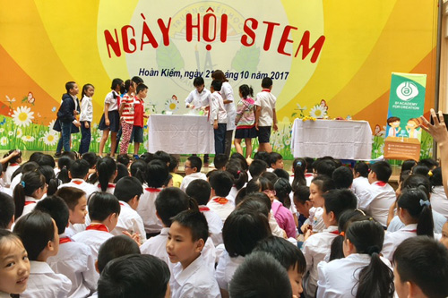
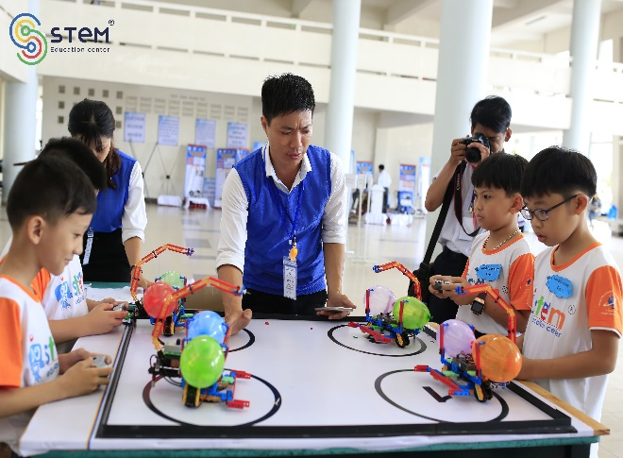
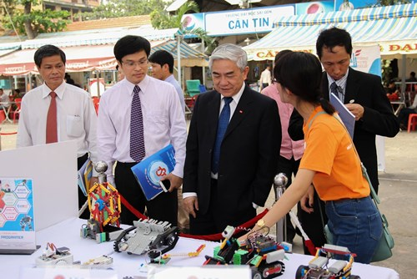
Stem fair
Science fair
Training for departments
Main course
Extra training service

Slide 11
EFFECTS AND RESPONSES
Positive responses from students, teachers and parents.
Counter-effect: STEM “SPIRIT” are presented at parliament and MoET.
Department of Science and Technology sponsored for STEM event.
Organizations and individuals give sponsorship to STEM fairs.

Slide 12
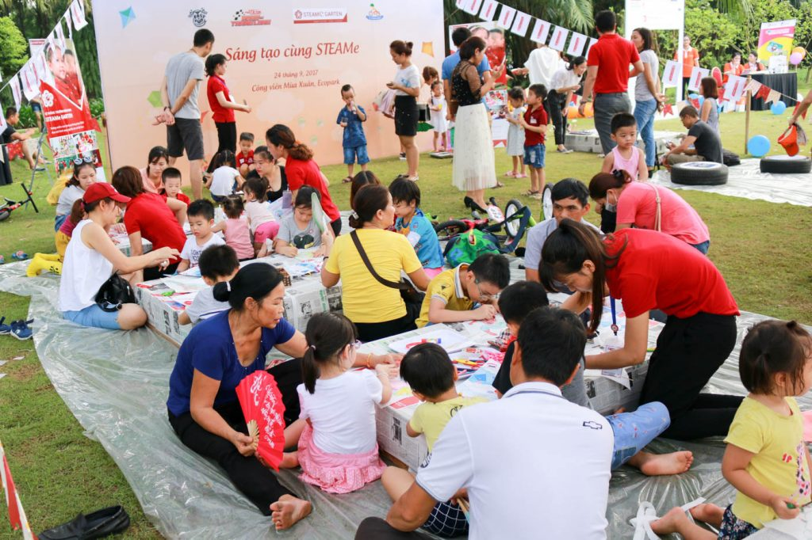
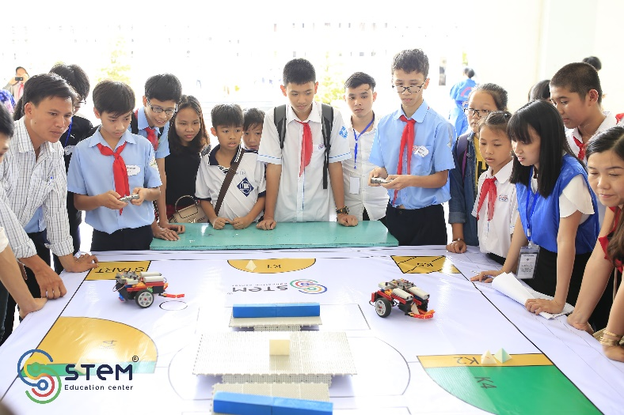
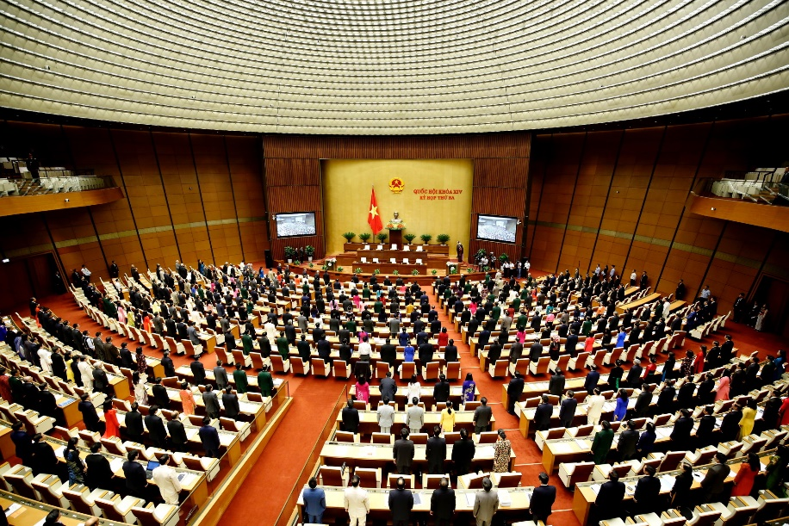

Slide 13
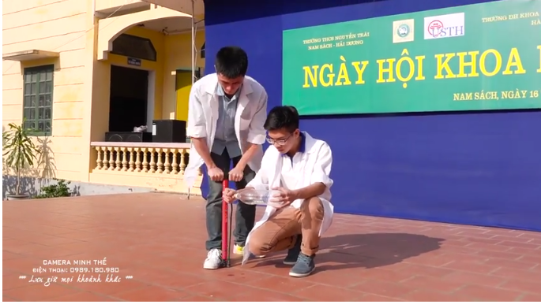
https://www.youtube.com/watch?v=ibhK9iU5j3M

Slide 14
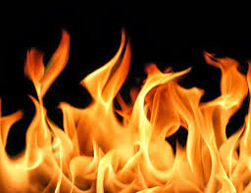
STEM intergrated subjects
from Texbooks
STEM Crafty Recycle
STEM Robotic and 3D printer

Slide 15
CONTRIBUTION OF VIETNAM STEM ASSOCIATION
20/64 provinces and cities are “covered” with STEM
STEM fairs are annually organized at large scale.
> 5000 teachers and 1000 principles receive STEM training.

Slide 16
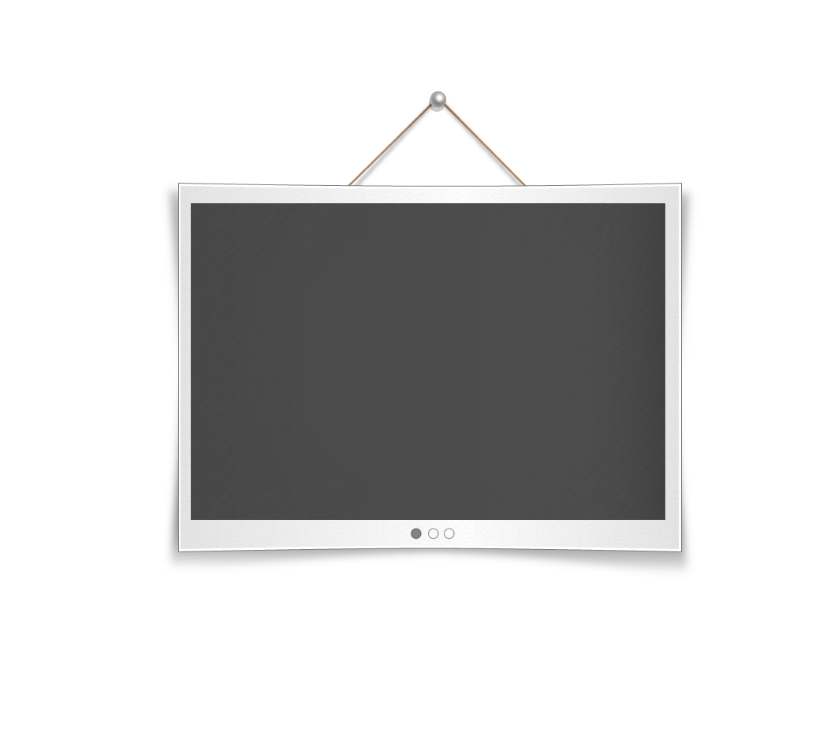
INITIATIVE of vietnam stem association
To erase STEM blindness
$1 for 1 teacher
$ 1 for 1 student
By organizing STEM fair and ToT
~850,000 teachers and ~17,000,000 students

Slide 17
CHALLENGE
Lack of policies from the government and the MoET
Lack of experts, finance and infrastructures
Gap between city and countryside
Weak communication

Slide 18
THE FUTURE OF STEM IN VIETNAM
Industrial 4.0 starts in Vietnam in informal ways.
We do believe that we will have a team of skilled labors thanks to these efforts.

Slide 19
