Slide 1
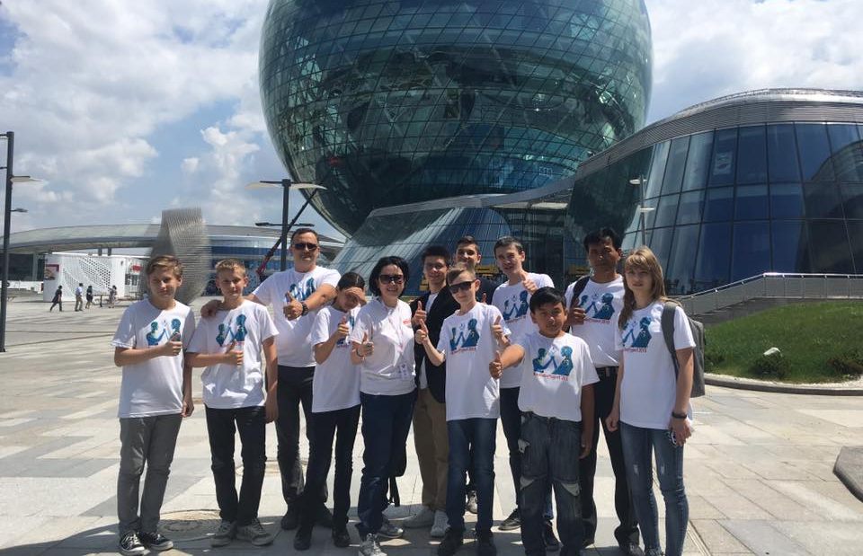
KazRobotics Federation RPA (NGO) Kazakhstan
Aizhan Zhekeyeva
Co-Founder and President

Slide 2
NAME: KazRobotics RPA
Registered: 17 JUNE 2015
Headqarters: Astana, Kazakhstan
Mission: Developing Opportunities for Creative Youth Through Robotics Clubs

Slide 3
OUR GOALS
Popularization of Educational Robotics and STEM in Kazakhstan and Worldwide
Making Opportunities for Creative Youth and Perspective Employers to meet for the future projects of Career Development (STEM Fairs and etc)
Rise possibilities for the Cultural and Scientific Exchanges both local and International
Overall support for Creative Kids and Youth of any type of schooling and income
Developing Human Resources for the Educational Robotics (trainers, teachers, coaches, mentors, judges and other experts)

Slide 4
OUR ACTIVITIES
Database of Centers and Clubs
KazRoboProject Contest
KazRoboSport Championship
Fund rising, looking for sponsors and support
Consulting for local schools, clubs and centers
Analyzing the local and international trends
Supporting teachers and kids

Slide 5
Our basic principles:
Volunteering
Open for everybody with no exceptions
No brand names preferences at our contests and championships
Career guidance and support

Slide 6
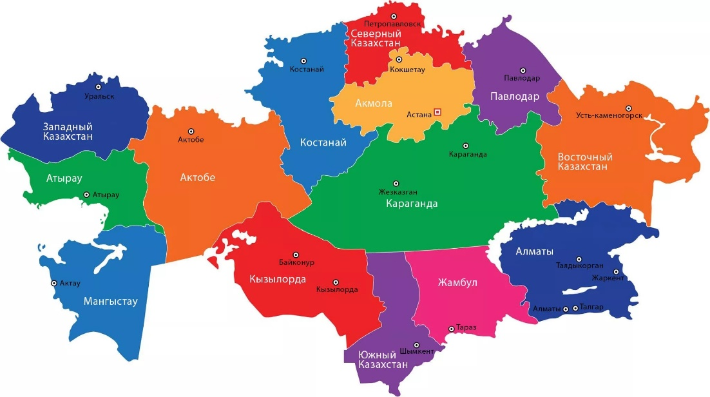
KazRobotics
2015 – 1 region – 30 kids
2016 – 8 regions – 400 kids
2017 – 14 regions – 1300 kids
2018 – 16 regions – 3000 kids
2019 – 17 regions – 4000 kids

Slide 7
Trainings for trainers
Coding
Science Projects
Contests management

Slide 8
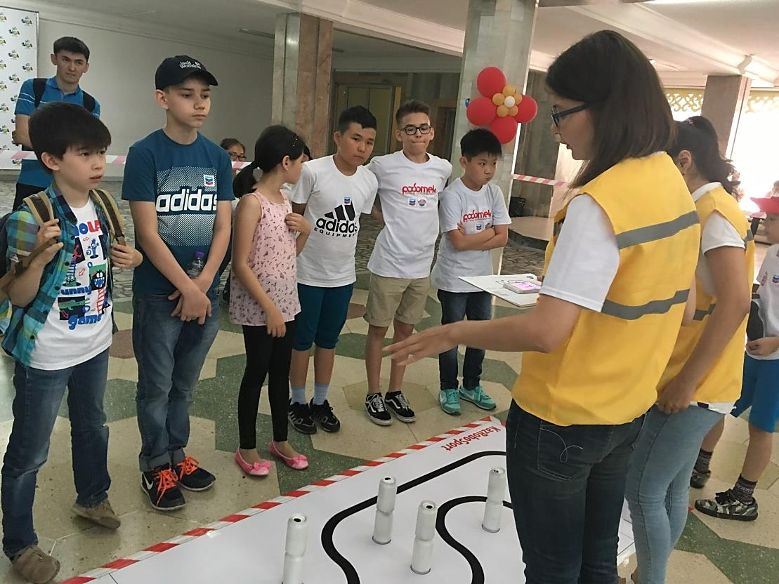
All the Judges are Volunteers
They are trained and certified by Federation

Slide 9
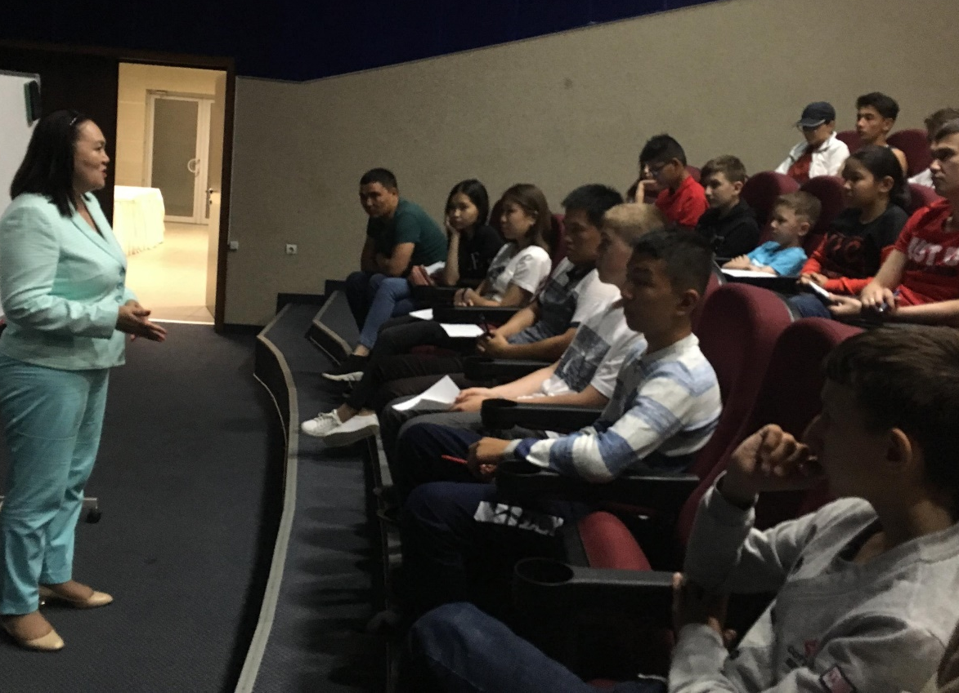
Meet ups with experts
Visiting future job places

Slide 10
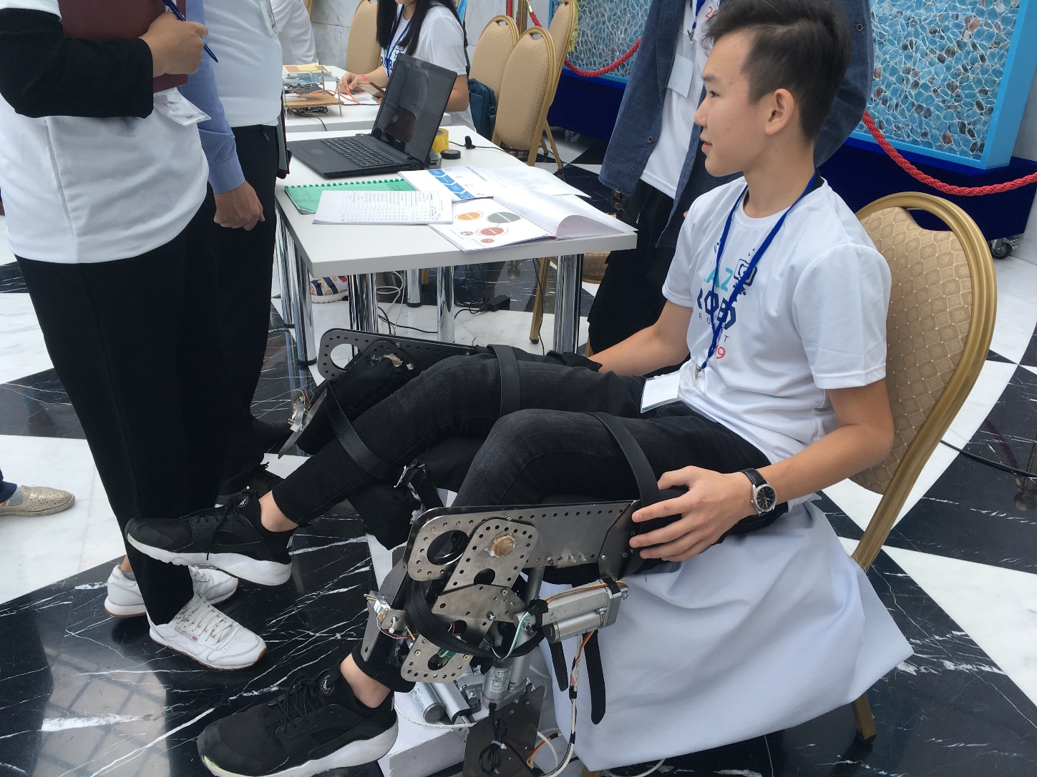
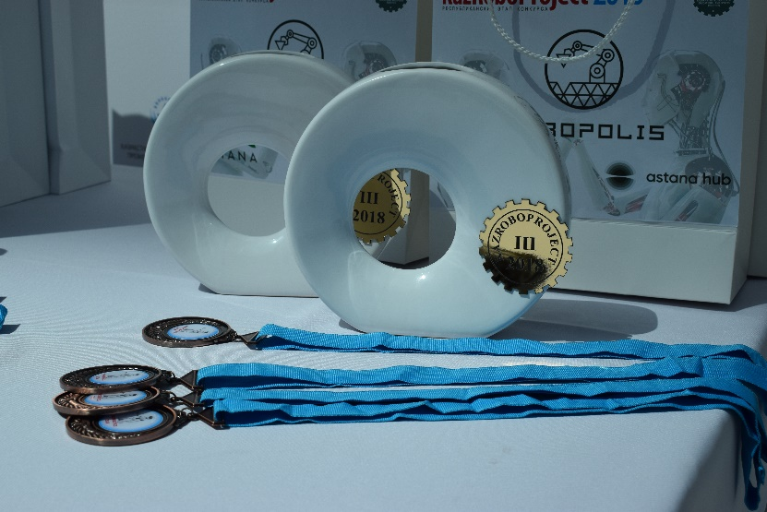
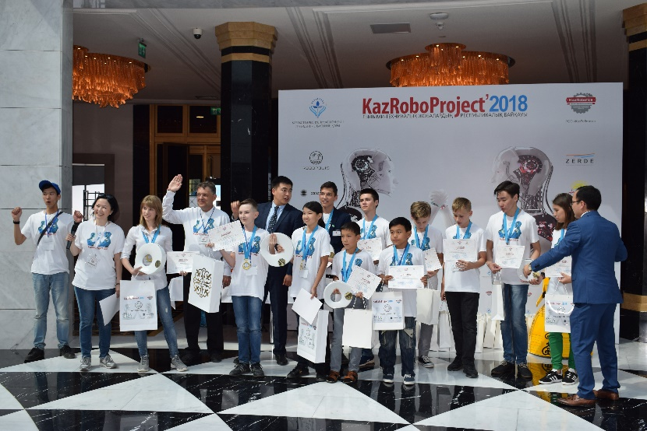
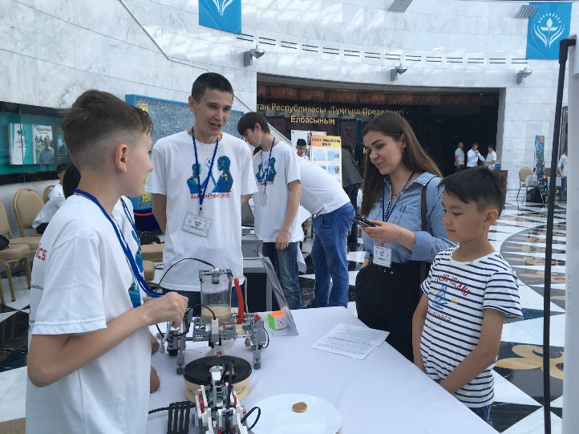
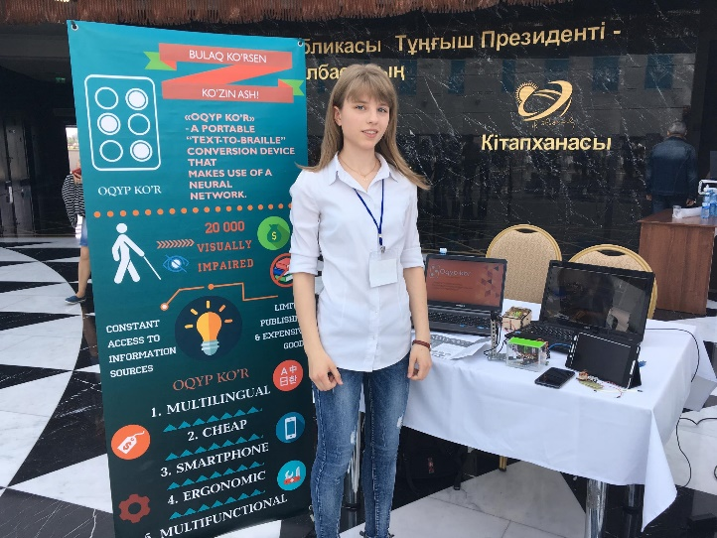
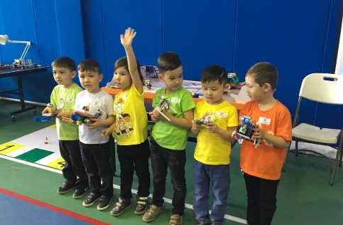

Slide 11
Our motto: Unite to Develop

